Slide 1
Revealing β-diversity patterns from the unexpected high coral Diversity from Mesophotic Coral Ecosystems
Manuscript structure, form and figures
Notes:
Corals from Mesophotic coral ecosystems host higher diversity than shallow and increase β-diversity

Slide 2
Introduction (4 paragraphs)
Diversity of mesophotic coral ecosystems. Still very unknown but from little we know there’s a lot of diversity
Patterns of diversity. Importance in management. Explain very shortly the indexes as we do not want to lose audience - especially beta-diversity.
Patterns of diversity in the ocean, in coral reefs. Little known in vertical depth in MCEs
Aims of the study
(1) presenting the vertical profiles of coral cover and generic richness with depth
(2) assessing the coral diversity with increasing depth.
(3) uncovering/predicting the beta-diversity patterns of mesophotic coral ecosystems with depth
Notes:
ICI TU DEVRAIS ETRE CAPABLE D’ECRIRE

Slide 3
M & M (5 paragraphs)
Available data. Data acquisition (photoquadrats). Generic richness PA, Occupancy-Frequency (n quadrat present/ total n quadrats) and Coral Cover.
Counterbalancing generic level vs. species level
Vertical profiles with depth. Coral-cover (Mixed-model, lmer) and PA-generic richness (MDE per island, RangemodelR)
Ordination and multi-dimensional scaling NMDS for the three databases:
- PA,
- Occupancy (Frequency)
- Coral cover
Diversity analysis. for the three databases: PA, Occupancy (Frequency), Coral cover. “Jaccard” and “Bray” index.family
1. Check variance and homocedasticity of beta-diversity for the different depths. Betadisper (beta-diversity, group = Depths)
2. Estimation of pair-wise beta-diversity per separate depths (beta.pair), boxplot of beta-diversity distances per depth and linear model of mean values with increasing depth
3. Correlation of pair-wise beta-diversity with geographical distance

Slide 4
Results (2 main sections) - but, short introduction of species level vs genus level; closing short paragraph saying that for three database approaches similar/same patterns)
* Genus level vs species level. Comment the correlations from open-access and available databases.
1. Vertical profiles (a) coral cover decreases with depth “mixed model” and (b) generic richness relationship with depth “MDE”
2. (a) database PA
NMDS
Variance, homocedasticity “betadisper” distance to median, anovas for depths…
Regressions of “beta.pair” beta.diversity per different depths with increasing depth
Mantel relation with geographical distance (no patterns)
(b) database Occupancy
NMDS
Variance, homocedasticity “betadisper” distance to median, anovas for depths…
Regressions of “beta.pair” beta.diversity per different depths with increasing depth
Mantel relation with geographical distance (no patterns)
(c) database Coral cover.
NMDS
Variance, homocedasticity “betadisper” distance to median, anovas for depths…
Regressions of “beta.pair” beta.diversity per different depths with increasing depth
Mantel relation with geographical distance (no patterns)
** Similarities in conclusions of three databases. Same sampling effort but different ecological measures.
Notes:
Although figures will be like:
Fig 1 vertical profiles (a) and (b)
Fig 2 NMDS for three databases and boxplot of distances to median from “betadisper” for the three databases
Fig 3 regression between beta.diversity and increasing depth for the three databases

Slide 5
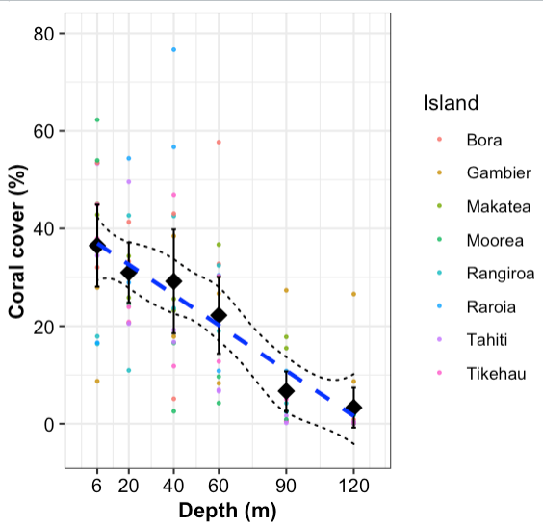
Visualization: Coral decreases in a general way. Black points are means.
Statistical tests:
What? If coral decreases with depth
Why? Because this is the departing hypothesis
How? Mixed-model “lmer” with random site intercept as not interested in island variations.
Interpretation: Coral cover decreases with depth with this equation :
Cover = Depth*(-0.3108) + 38.82
Opinion: I checked different mixed models options and I kept the simplest number of variables with lowest AIC and BIC. However, I am not sure how good is this model and the percentage of data that it explains... You have the command and the output from R in comments
Coral cover vs depth
Red -> Mean and error bars “stat_summary”
Points -> Islands coral cover
Blue dashed line -> predicted values from mixed model
Black dashed line -> geom_ribbon, stat = “smooth”, method = “loess”
I think this figure should be 1a
Notes:
Outputs from R:
> mixed.lmer <- lmer(Cover ~ Depth + (1|Island_Site_2), data = coral_cover2)
boundary (singular) fit: see ?isSingular
> summary(mixed.lmer)
Linear mixed model fit by REML ['lmerMod']
Formula: Cover ~ Depth + (1 | Island_Site_2)
Data: coral_cover2
REML criterion at convergence: 758.1
Scaled residuals:
Min 1Q Median 3Q Max
-2.0718 -0.6749 -0.1043 0.5883 3.6876
Random effects:
Groups Name Variance Std.Dev.
Island_Site_2 (Intercept) 0.0 0.00
Residual 185.6 13.63
Number of obs: 94, groups: Island_Site_2, 16
Fixed effects:
Estimate Std. Error t value
(Intercept) 38.82288 2.43156 15.966
Depth -0.31038 0.03632 -8.546
Correlation of Fixed Effects:
(Intr)
Depth -0.816
convergence code: 0
boundary (singular) fit: see ?isSingular

Slide 6
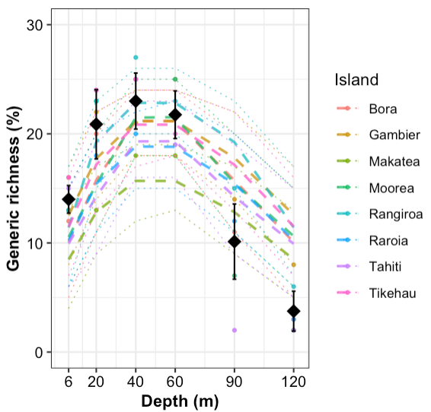
Visualization: Generic richness peaks at 20-60m. The mean of generic richness for all islands is in black with se, colour points show observed generic richness in islands, dashed show predicted richness with lower and upper CI per islands
Statistical tests:
What? If there is a mid-domain-effect
Why? I want to see if excepcional or conserved in all islands.
How? Mid-Domain-Test with a simulation model “rangemod1d” for each island Gotelli et al 2009.
Check results in next slide.
Interpretation: Predicted richness is close to observed richness. We can see that there is a mid-domain-effect in all islands. This answers the question and can be used to predict diversity. This mid-domain-depth of maximum richness goes in between 20 and 60 among islands.
Opinion: However, I am not sure if it is fine that in some islands, the richness is not so close to the predicted values or outside the interquartiles. For example Tahiti, or in Moorea and Tikehau at very big depths where there are very few corals. (Check next slide)
Generic richness (PA) vs Depth
Black -> Mean and error bars “stat_summary”
Points -> Richness per island
Dashed line -> predicted values from rangemod (mod.rich)
Dotted line -> interquartiles q2.5 and 97.5 from mod.rich
I think this figure should be 1b

Slide 7
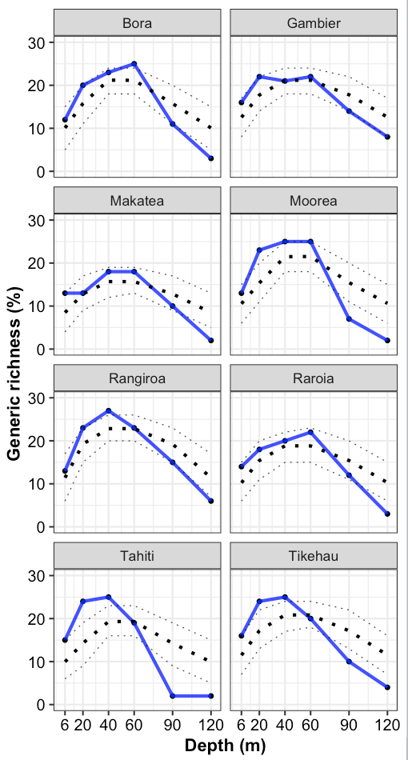
Generic richness and mid-domain-effect predicted values per island
Visualization: Generic richness is in blue, predicted in black with lower and upper confidence intervals (dashed line).
Statistical tests:
Interpretation: Predicted richness is close to observed richness. We can see that there is a mid-domain-effect in all islands. This answers the question and can be used to predict diversity. This mid-domain-depth of maximum richness goes in between 20 and 60 among islands.
-Opinion: However, I am not sure if it is fine that in some islands, the richness is not so close to the predicted values or outside the interquartiles. For example Tahiti, or in Moorea and Tikehau at very big depths where there are very few corals. I think not necessary to improve the figure, as maximum we’ll go as supplementary data or not even that. I think previous figure is enough. Should I apply extra stats for seeing the accuracy of predicted values vs observed to have p-values?

Slide 8
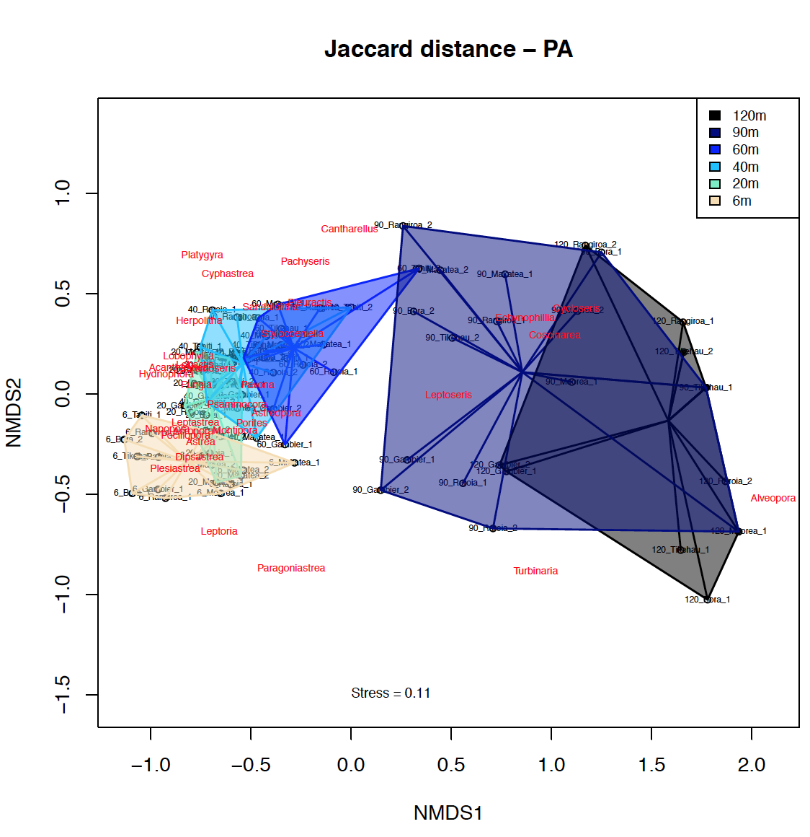
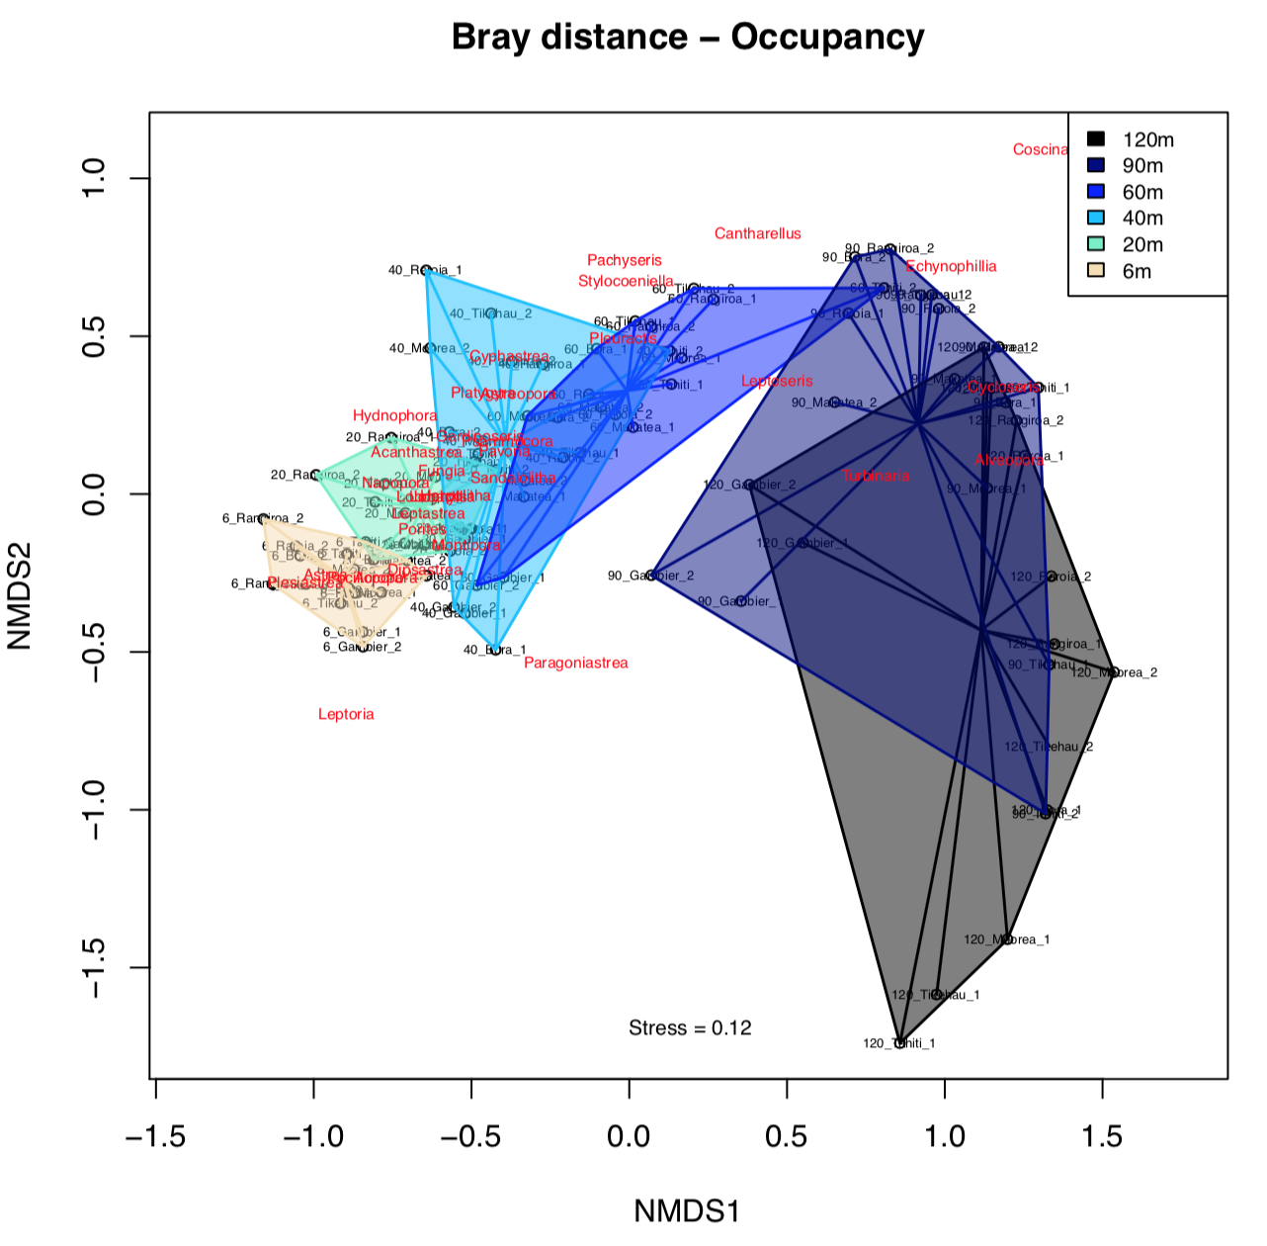
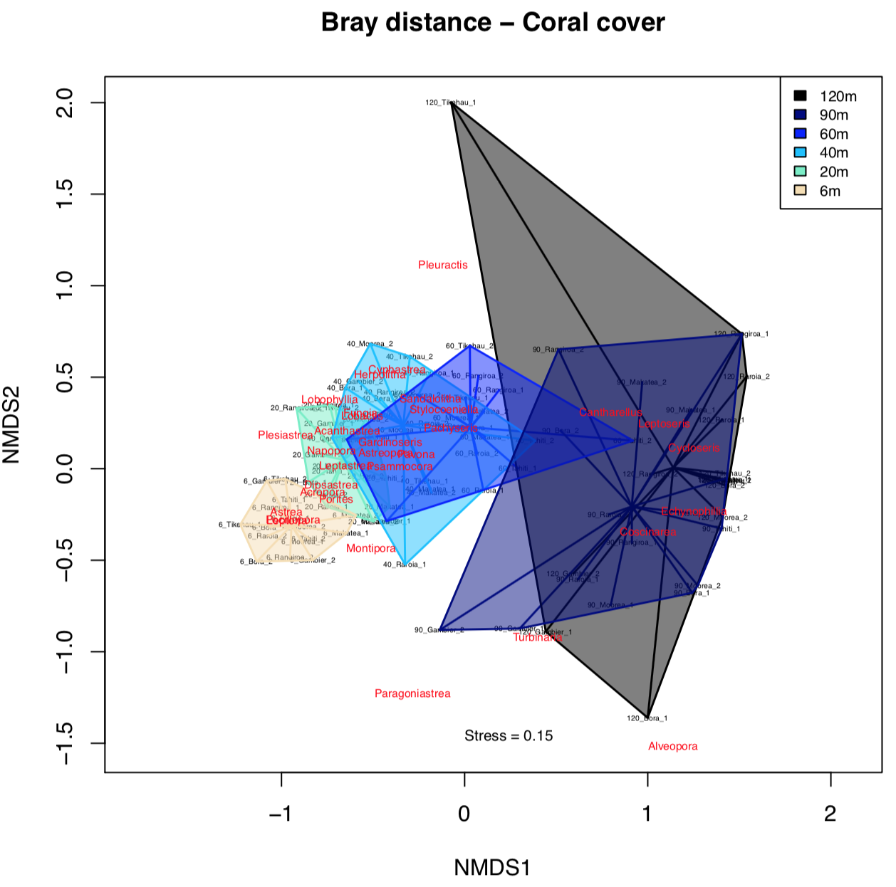
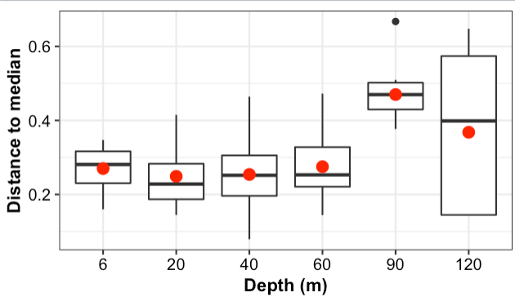
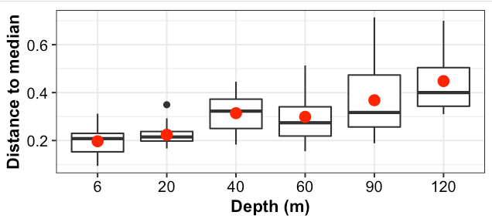
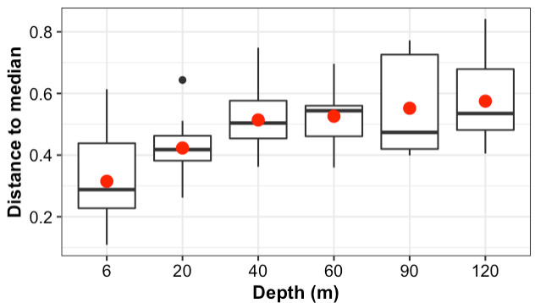
Personally, I think this is figure 2. NMDS (above) and distance to median with betadisper (below)
Details and interpretations more explained in the next slides

Slide 9
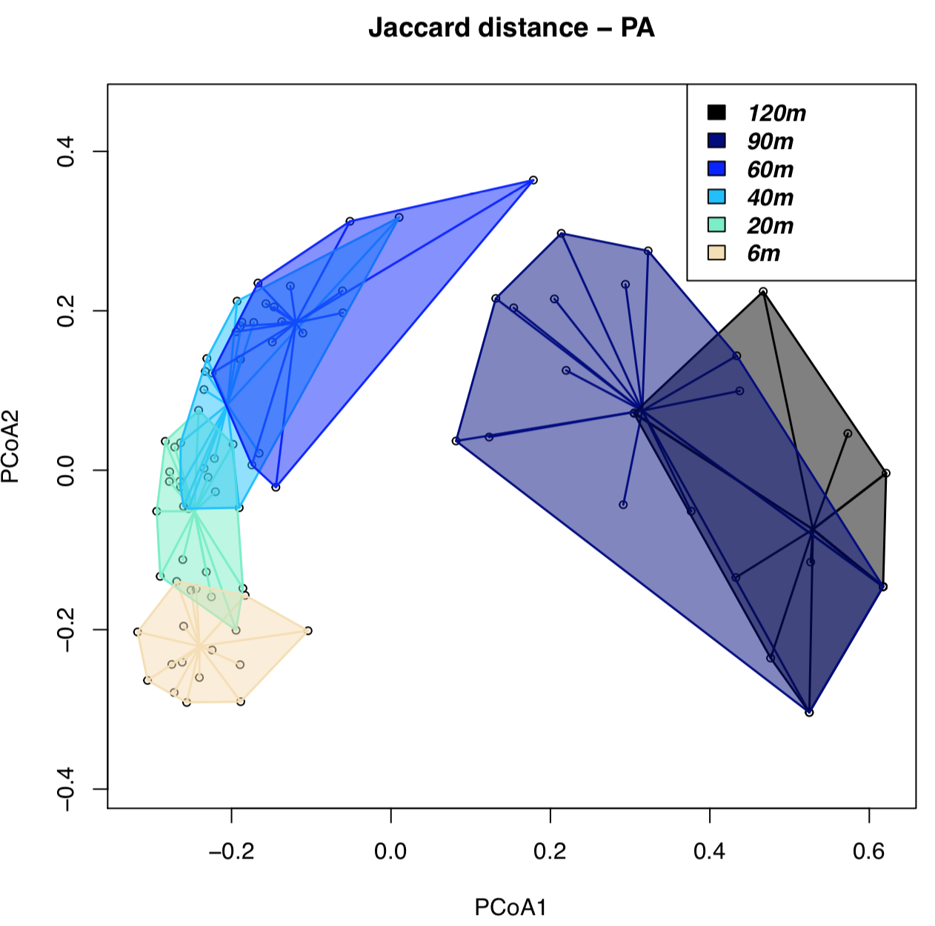
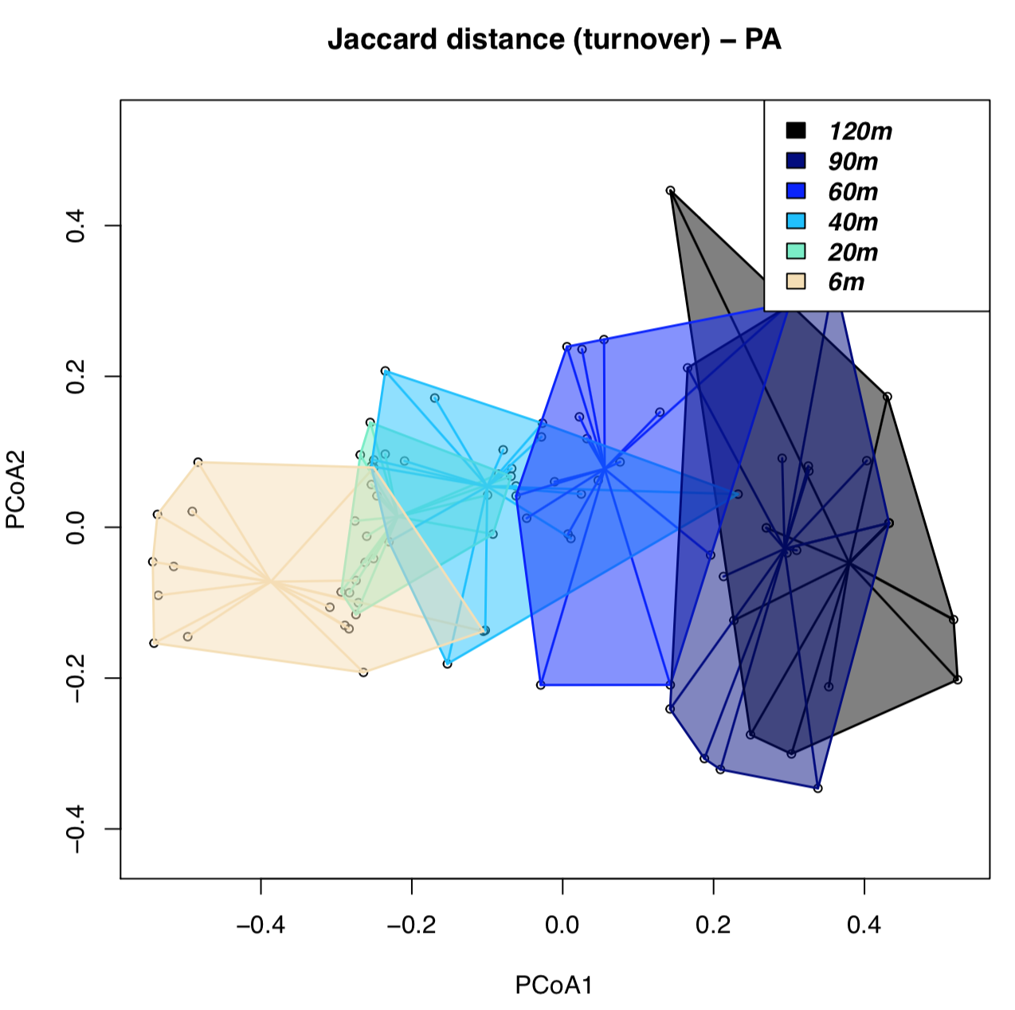
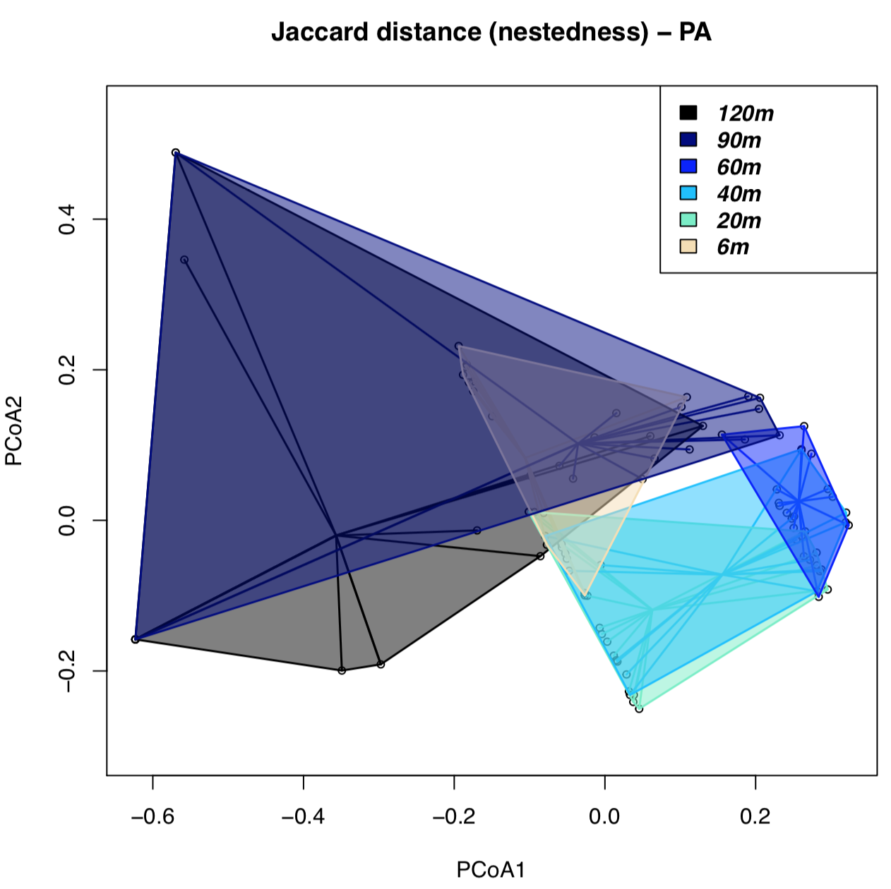
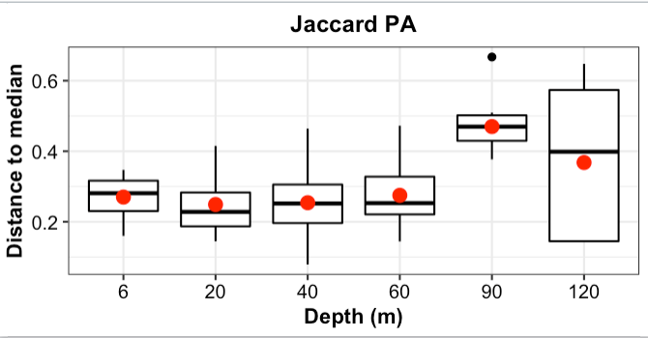
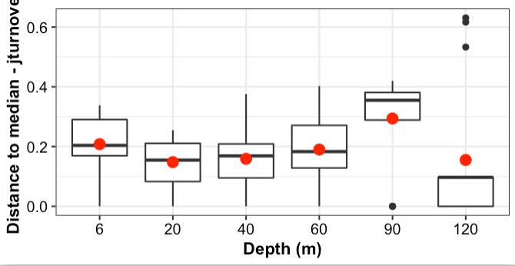
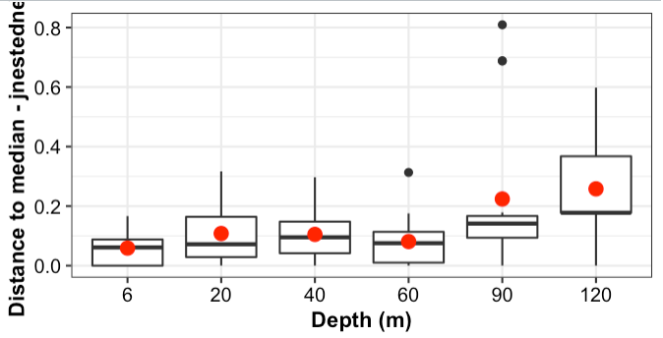
PA - Jaccard distance, Turnover and Nestedness
Beta.pair from (rows = Depth_Sites, cols = Genus) → Obtain 3 distances: (1) beta.pair$Jac; (2) beta.pair$jtu; (3) beta.pair$jne → betadisper (Beta = (1-3),groups = Depths)
NMDS and distance to median from overall jaccard and its turnover and nestedness components
Notes:
*I can’t plot species (genus) in the NMDS
Jaccard
Homogeneity of multivariate dispersions
Call: betadisper(d = Beta_Depth, group = groups)
No. of Positive Eigenvalues: 33
No. of Negative Eigenvalues: 53
Average distance to median:
120M 20M 40M 60M 6M 90M
0.3677 0.2492 0.2539 0.2751 0.2698 0.4702
Eigenvalues for PCoA axes:
(Showing 8 of 86 eigenvalues)
PCoA1 PCoA2 PCoA3 PCoA4 PCoA5 PCoA6 PCoA7 PCoA8
9.4645 2.8278 1.9605 1.1360 0.9263 0.8936 0.8379 0.7532
> anova(mod_Depth)
Analysis of Variance Table
Response: Distances
Df Sum Sq Mean Sq F value Pr(>F)
Groups 5 0.61386 0.122771 9.5869 2.412e-07 ***
Residuals 89 1.13974 0.012806
---
Signif. codes: 0 ‘***’ 0.001 ‘**’ 0.01 ‘*’ 0.05 ‘.’ 0.1 ‘ ’ 1
> permutest(mod_Depth, pairwise = TRUE, permutations = 99)
Permutation test for homogeneity of multivariate dispersions
Permutation: free
Number of permutations: 99
Response: Distances
Df Sum Sq Mean Sq F N.Perm Pr(>F)
Groups 5 0.61386 0.122771 9.5869 99 0.01 **
Residuals 89 1.13974 0.012806
---
Signif. codes: 0 ‘***’ 0.001 ‘**’ 0.01 ‘*’ 0.05 ‘.’ 0.1 ‘ ’ 1
Pairwise comparisons:
(Observed p-value below diagonal, permuted p-value above diagonal)
120M 20M 40M 60M 6M 90M
120M 6.0000e-02 9.0000e-02 1.4000e-01 1.2000e-01 0.06
20M 4.6938e-02 8.8000e-01 4.0000e-01 4.7000e-01 0.01
40M 6.4822e-02 8.9194e-01 5.7000e-01 6.1000e-01 0.01
60M 1.1767e-01 4.1335e-01 5.4733e-01 8.5000e-01 0.01
6M 8.2972e-02 4.3178e-01 6.0114e-01 8.4362e-01 0.01
90M 7.4387e-02 5.6203e-09 1.2884e-07 1.0366e-07 3.8589e-10
JAccard Turnover
> mod_Depth
Homogeneity of multivariate dispersions
Call: betadisper(d = Beta_jtu_Depth, group = groups)
No. of Positive Eigenvalues: 35
No. of Negative Eigenvalues: 51
Average distance to median:
120M 20M 40M 60M 6M 90M
0.1547 0.1477 0.1587 0.1899 0.2080 0.2937
Eigenvalues for PCoA axes:
(Showing 8 of 86 eigenvalues)
PCoA1 PCoA2 PCoA3 PCoA4 PCoA5 PCoA6 PCoA7 PCoA8
8.0279 1.9970 1.6706 1.4170 1.3194 0.9963 0.7792 0.6821
> anova(mod_Depth)
Analysis of Variance Table
Response: Distances
Df Sum Sq Mean Sq F value Pr(>F)
Groups 5 0.23962 0.047925 2.4588 0.03904 *
Residuals 89 1.73468 0.019491
---
Signif. codes: 0 ‘***’ 0.001 ‘**’ 0.01 ‘*’ 0.05 ‘.’ 0.1 ‘ ’ 1
> # Permutation test for F
> permutest(mod_Depth, pairwise = TRUE, permutations = 99)
Permutation test for homogeneity of multivariate dispersions
Permutation: free
Number of permutations: 99
Response: Distances
Df Sum Sq Mean Sq F N.Perm Pr(>F)
Groups 5 0.23962 0.047925 2.4588 99 0.04 *
Residuals 89 1.73468 0.019491
---
Signif. codes: 0 ‘***’ 0.001 ‘**’ 0.01 ‘*’ 0.05 ‘.’ 0.1 ‘ ’ 1
Pairwise comparisons:
(Observed p-value below diagonal, permuted p-value above diagonal)
120M 20M 40M 60M 6M 90M
120M 0.9100000 0.9600000 0.6600000 0.4000000 0.06
20M 0.9112175 0.7600000 0.2800000 0.1100000 0.01
40M 0.9503533 0.7455725 0.4900000 0.1700000 0.02
60M 0.5936597 0.2447415 0.4371336 0.7500000 0.08
6M 0.4099921 0.0761199 0.1951291 0.6473631 0.06
90M 0.0563631 0.0019212 0.0067397 0.0384978 0.0719387
Beta-Jaccard Nestedness
> mod_Depth
Homogeneity of multivariate dispersions
Call: betadisper(d = Beta_nte_Depth, group = groups)
No. of Positive Eigenvalues: 48
No. of Negative Eigenvalues: 38
Average distance to median:
120M 20M 40M 60M 6M 90M
0.25837 0.10821 0.10536 0.08093 0.05940 0.22447
Eigenvalues for PCoA axes:
(Showing 8 of 86 eigenvalues)
PCoA1 PCoA2 PCoA3 PCoA4 PCoA5 PCoA6 PCoA7 PCoA8
6.7341 2.0660 1.7443 1.4120 0.8432 0.6520 0.4899 0.3835

Slide 10
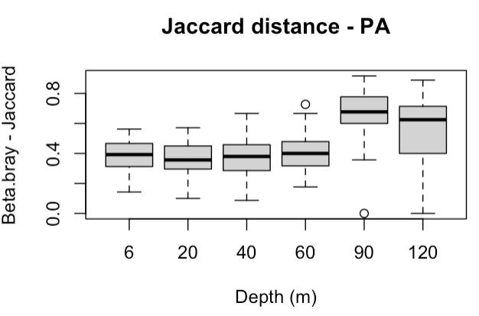
PA - Jaccard distance, Turnover and Nestedness
Values of beta jaccard, turn and nest for the different depth groups (values are the average distance to median from betadisper) - Groups are the Depths
Mantel-tests of beta-jac (not turnover and nestedness) from initial beta.pair for each separate depth with geographical distance
Depth | Beta-jac | Turn | Nest | Mantel Stat. | Signif.
6m | 0.26982 | 0.2080 | 0.0594 | 0.181 | 0.08
20m | 0.249193 | 0.1477 | 0.1082 | 0.0675 | 0.313
40m | 0.253898 | 0.1587 | 0.1053 | 0.1323 | 0.243
60m | 0.275102 | 0.1899 | 0.0809 | 0.3793 | 0.026
90m | 0.470154 | 0.2937 | 0.2244 | 0.1779 | 0.088
120m | 0.367717 | 0.1547 | 0.2584 | 0.4655 | 0.003
Lm (beta_jac ~ Depth)
beta.div = 0.0015124· x (Depth) + 0.2296226**
Multiple R-squared: 0.553
p-value: 0.09015

Slide 11
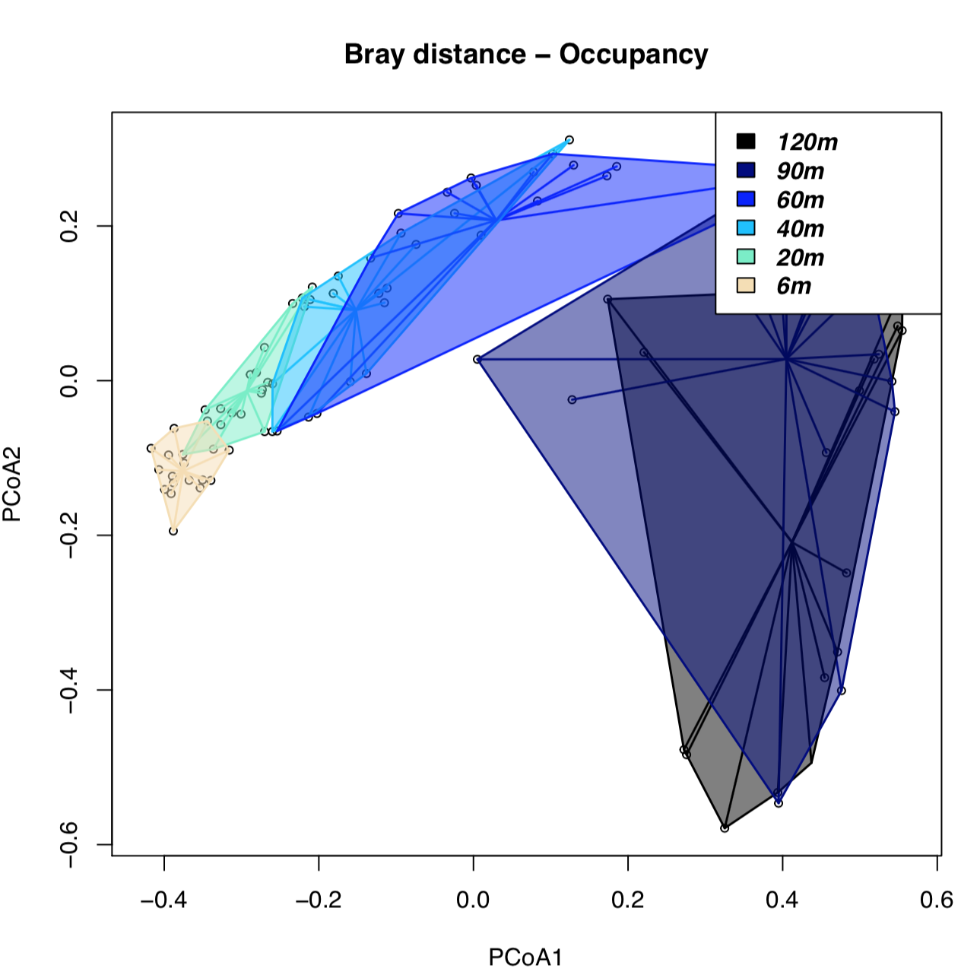
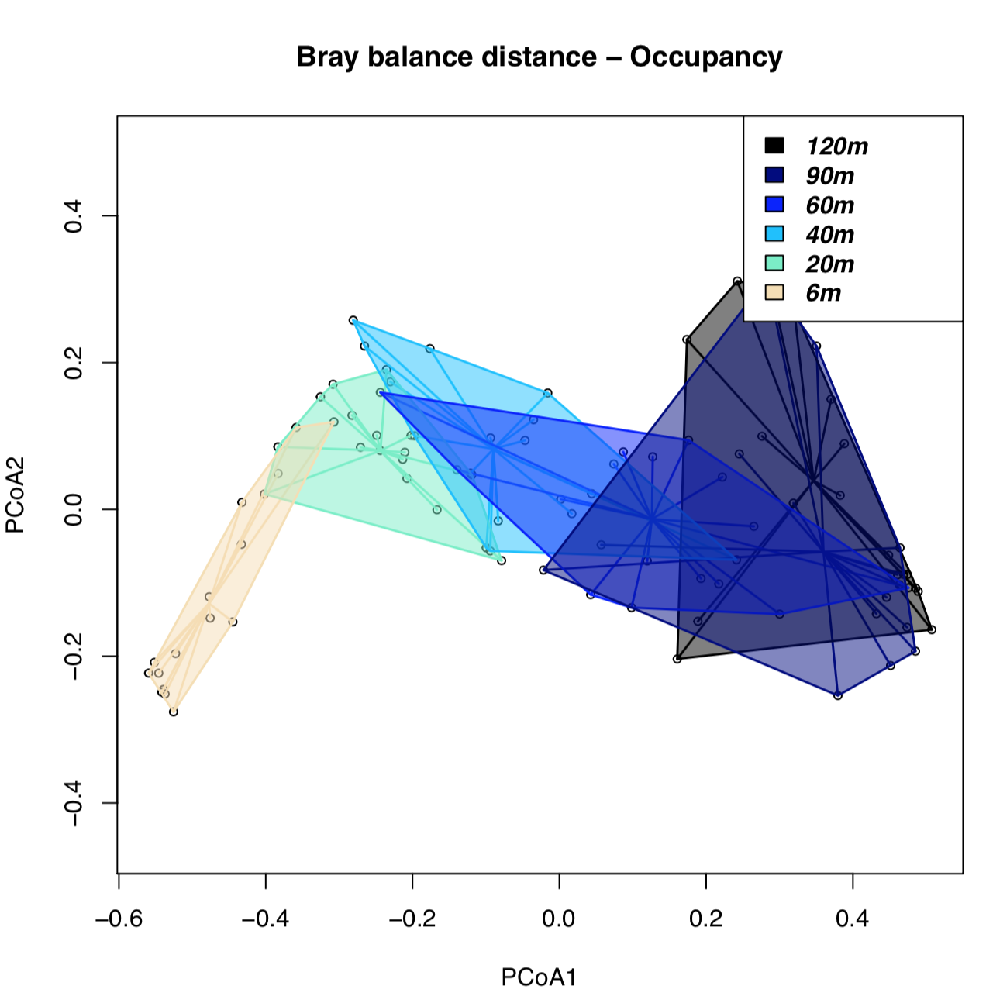
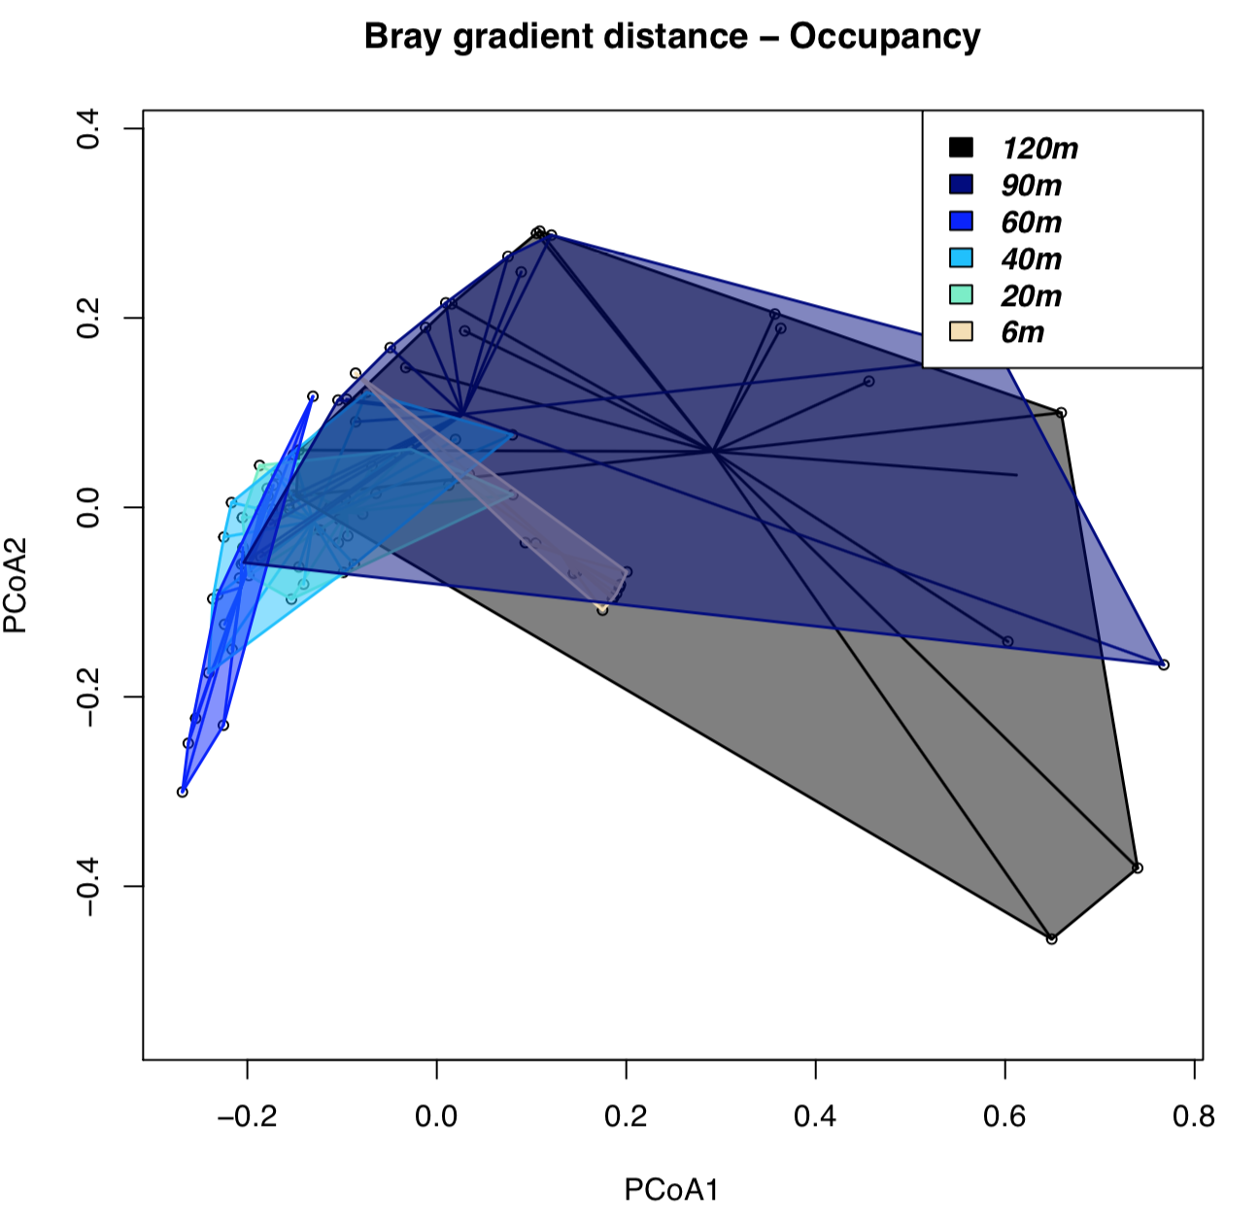
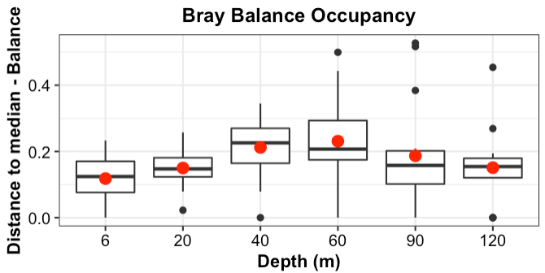
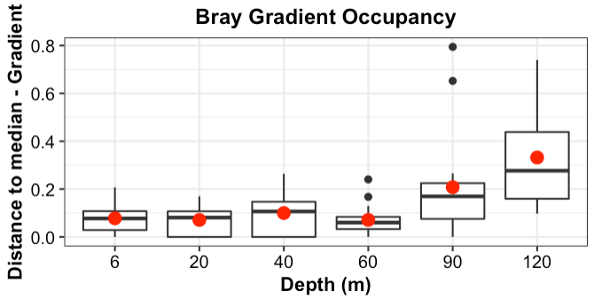
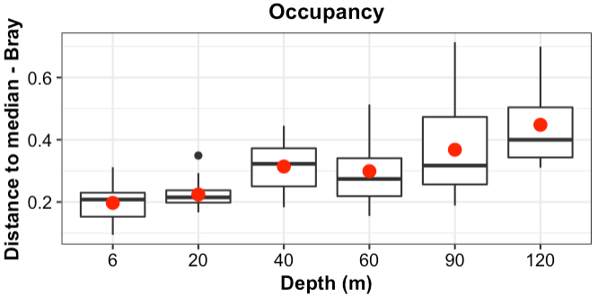
Occupancy - Bray distance, Balance and Gradient
Beta.pair from (rows = Depth_Sites, cols = Genus) → Obtain 3 distances: (1) beta.pair.abund$beta.bray; (2) beta.pair$beta.bray.bal; (3) beta.pair$beta.bray.gra → betadisper (Beta = (1-3),groups = Depths)
NMDS and distance to median from overall jaccard and its turnover and nestedness components

Slide 12
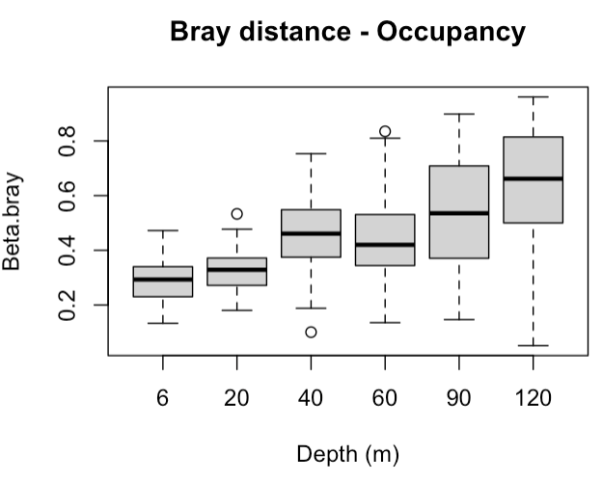
Occupancy - Bray distance, Balance and Gradient
Values of beta jaccard, turn and nest for the different depth groups (values are the average distance to median from betadisper) - Groups are the Depths
Mantel-tests of beta-jac (not turnover and nestedness) from initial beta.pair for each separate depth with geographical distance
Depth | Beta-bray | Bray.balance | Bray.gradient | Mantel Stat. | Signif.
6m | 0.1973 | 0.1179 | 0.08735 | 0.2652 | 0.061
20m | 0.2243 | 0.1504 | 0.0706 | -0.894 | 0.667
40m | 0.319 | 0.2121 | 0.0999 | 0.2636 | 0.039
60m | 0.2988 | 0.2307 | 0.0708 | 0.5853 | 0.007
90m | 0.3682 | 0.1870 | 0.2078 | 0.3985 | 0.038
120m | 0.4484 | 0.1508 | 0.33217 | 0.1937 | 0.094
Lm (beta_jac ~ Depth)
beta.div = 0.0020864*** x (Depth) + 0.1916375***
Multiple R-squared: 0.9501
p-value: 0.0009498

Slide 13
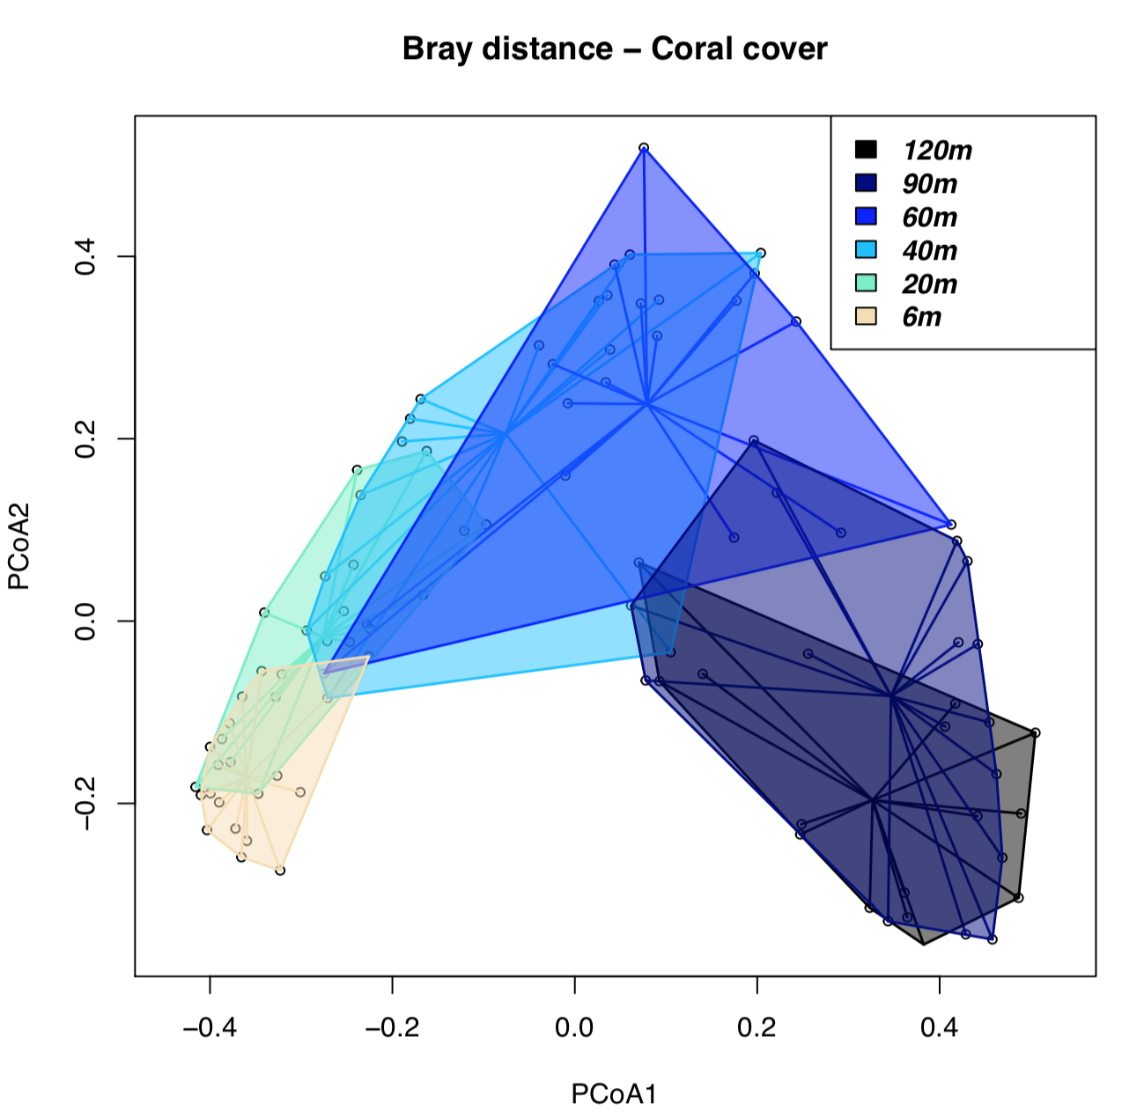
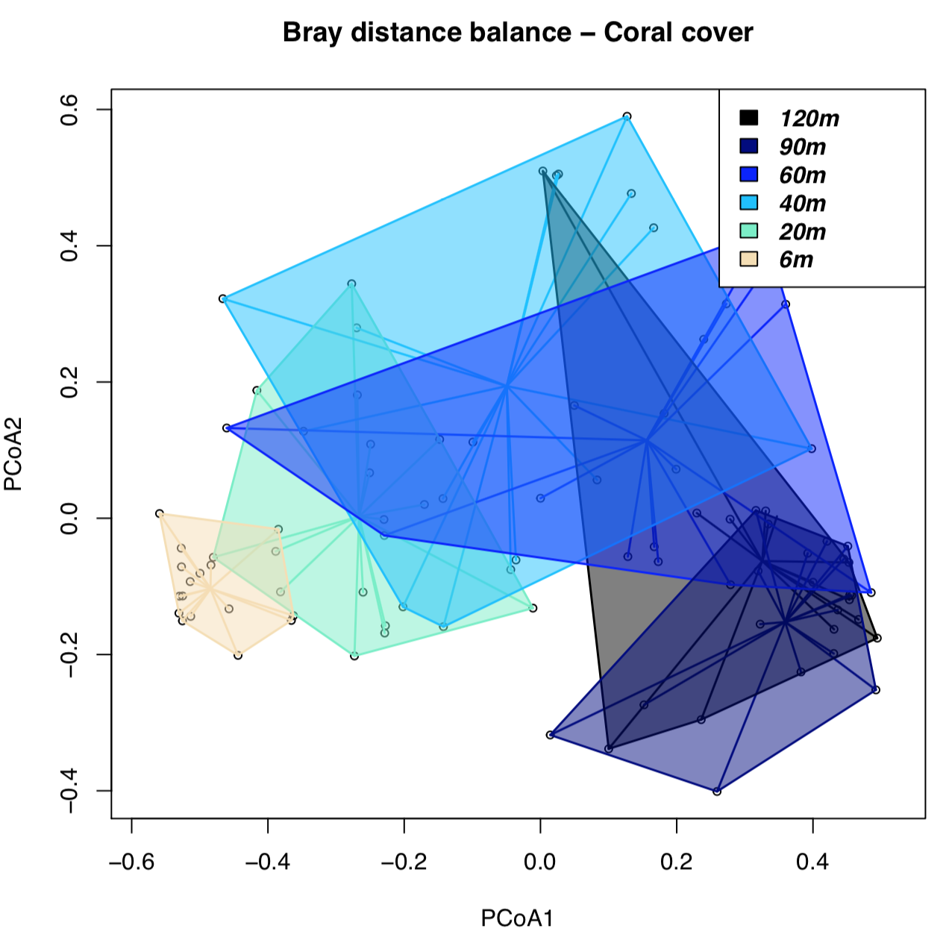
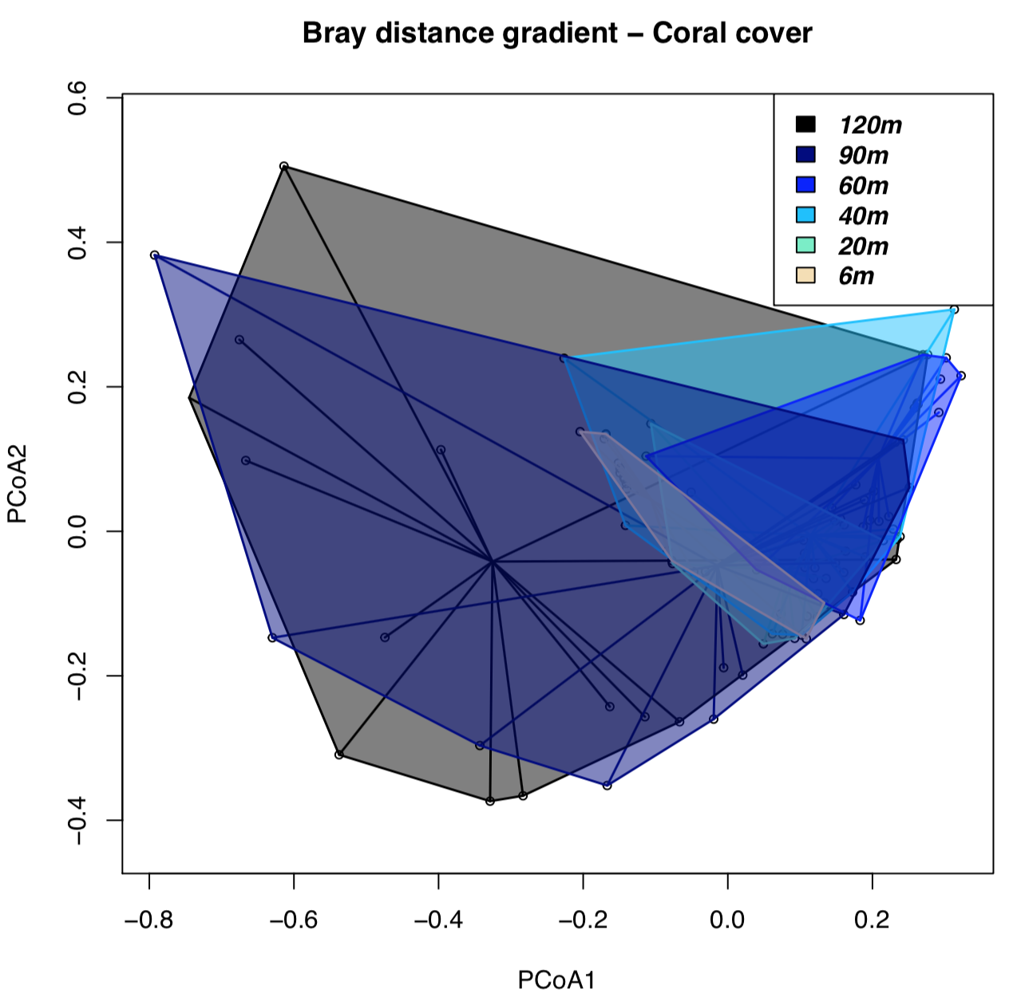
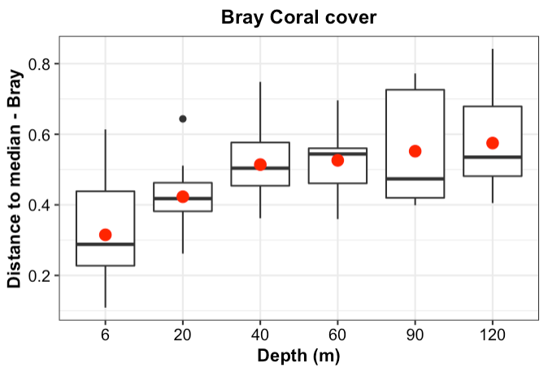
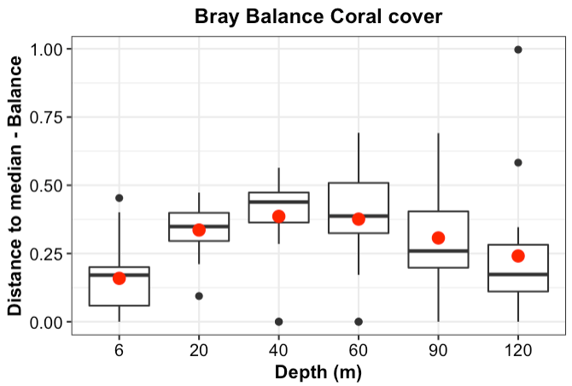
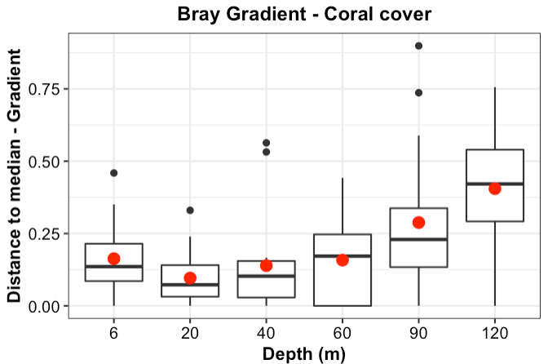
Coral cover - Bray distance, Balance and Gradient
Beta.pair from (rows = Depth_Sites, cols = Genus) → Obtain 3 distances: (1) beta.pair.abund$beta.bray; (2) beta.pair$beta.bray.bal; (3) beta.pair$beta.bray.gra
betadisper (Beta = (1-3),groups = Depths)
NMDS and distance to median from overall jaccard and its turnover and nestedness components

Slide 14
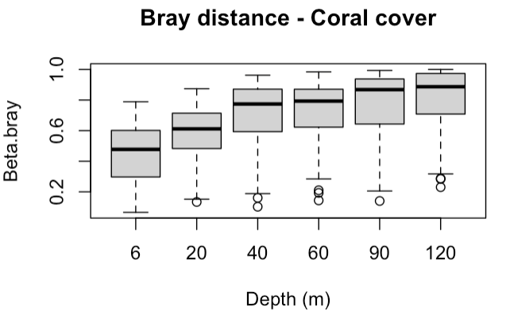
Coral cover - Bray distance, Balance and Gradient
Values of beta jaccard, turn and nest for the different depth groups (values are the average distance to median from betadisper) - Groups are the Depths
Mantel-tests of beta-jac (not turnover and nestedness) from initial beta.pair for each separate depth with geographical distance
Depth | Beta-bray | Bray.balance | Bray.gradient | Mantel Stat. | Signif.
6m | 0.3149 | 0.1593 | 0.16349 | 0.6298 | 0.001
20m | 0.4232 | 0.3365 | 0.09567 | 0.1142 | 0.155
40m | 0.5143 | 0.3858 | 0.13903 | 0.1585 | 0.107
60m | 0.5257 | 0.3758 | 0.15801 | 0.3241 | 0.004
90m | 0.5516 | 0.3065 | 0.28795 | 0.3752 | 0.013
120m | 0.5755 | 0.2413 | 0.40545 | 0.359 | 0.028
Lm (beta_jac ~ Depth)
beta.div = 0.0019825* x (Depth) + 0.3731680***
Multiple R-squared: 0.765
p-value: 0.02258

Slide 15
PA (0,1)
Visualization: The P-A of coral diversity is well clustered with depth. Beta-diversity (size of polygon) increases with depth. While shallow coral diversity is very homogeneous, deep corals more diverse. Each site looks unique.
Statistical tests:
What? (1) Is variance and homocedasticity really bigger dwith depth ? (2) Is beta-diversity really higher in depth ? (3) is beta-diversity correlated with distance at different depths?
Why? Because understanding beta-diversity patterns with depth has important implications in conservation
Continuation in next slide

Slide 16
PA (0,1)
How? (1) From PA matrix, using the beta-diver from “beta.jac” and doing “betadisper” will allow me to see the variance with distance to median per depth. “Anova” of betadisper, check if really depth is significantly contributing to increase variance, and permutest pair-wise comparisons between depths. (Check comments for output)
(2) using “beta.pair” at each different depth with “jaccard” family I can see beta-diversity and its components “beta.pair(Depth_X_Beta, index.family = "jaccard")” (3) using “mantel” correlation of beta-jac pair-wise distance of separate depths with geographical distance
Interpretation: (1) Distance to median almost does not change with increasing depth, Depth factoring is significant (2) Beta-diversity increases with depth, although some little exceptions 90m. I made an extra figure (next slide) to see the regresion between beta.div and increasing depth. (3) There are not correlations nor patterns of beta-diversity with geographical distance
Opinion: I kept the two components (turn and nes) because Valeriano wanted to see them. Personally, I won’t include them not to lose the pathway of the paper
(1) Distance to median from betadisper
(2) Beta-diversity with depth
(3) Mantel-tests of beta-jac with geographical distance
Depth | Beta-jac | Turn | Nest | Mantel Stat. | Signif.
6m | 0.3890 | 0.3101 | 0.0788 | 0.1527 | 0.126
20m | 0.3667 | 0.2057 | 0.1609 | 0.0903 | 0.302
40m | 0.3793 | 0.2289 | 0.1504 | 0.1603 | 0.198
60m | 0.4042 | 0.2891 | 0.1151 | 0.3848 | 0.016
90m | 0.6789 | 0.3338 | 0.3450 | 0.1539 | 0.1
120m | 0.5969 |  |  | 0.3051 | 0.068
Notes:
(1)
> mod_Depth <- betadisper (Beta_Depth,groups)
> mod_Depth
Homogeneity of multivariate dispersions
Call: betadisper(d = Beta_Depth, group = groups)
No. of Positive Eigenvalues: 46
No. of Negative Eigenvalues: 48
Average distance to median:
120M 20M 40M 60M 6M 90M
0.4484 0.2243 0.3139 0.2988 0.1973 0.3682
Eigenvalues for PCoA axes:
(Showing 8 of 94 eigenvalues)
PCoA1 PCoA2 PCoA3 PCoA4 PCoA5 PCoA6 PCoA7 PCoA8
10.3503 3.8844 1.8291 1.1541 0.9625 0.8460 0.8331 0.7019
> anova(mod_Depth)
Analysis of Variance Table
Response: Distances
Df Sum Sq Mean Sq F value Pr(>F)
Groups 5 0.66344 0.132688 12.319 4.369e-09 ***
Residuals 89 0.95862 0.010771
---
Signif. codes: 0 ‘***’ 0.001 ‘**’ 0.01 ‘*’ 0.05 ‘.’ 0.1 ‘ ’ 1
> # Permutation test for F
> permutest(mod_Depth, pairwise = TRUE, permutations = 99)
Permutation test for homogeneity of multivariate dispersions
Permutation: free
Number of permutations: 99
Response: Distances
Df Sum Sq Mean Sq F N.Perm Pr(>F)
Groups 5 0.66344 0.132688 12.319 99 0.01 **
Residuals 89 0.95862 0.010771
---
Signif. codes: 0 ‘***’ 0.001 ‘**’ 0.01 ‘*’ 0.05 ‘.’ 0.1 ‘ ’ 1
Pairwise comparisons:
(Observed p-value below diagonal, permuted p-value above diagonal)
120M 20M 40M 60M 6M 90M
120M 1.0000e-02 1.0000e-02 1.0000e-02 1.0000e-02 0.17
20M 4.9842e-07 1.0000e-02 1.0000e-02 1.9000e-01 0.01
40M 1.4382e-03 4.1189e-04 6.4000e-01 1.0000e-02 0.29
60M 1.5721e-03 1.6867e-02 6.4992e-01 1.0000e-02 0.13
6M 1.1270e-07 1.6338e-01 3.7132e-05 2.4265e-03 0.01
90M 1.3494e-01 1.4882e-03 2.2532e-01 1.5627e-01 3.1772e-04
> TukeyHSD(mod_Depth)
Tukey multiple comparisons of means
95% family-wise confidence level
Fit: aov(formula = distances ~ group, data = df)
$group
diff lwr upr p adj
20M-120M -0.22407564 -0.33271954 -0.115431748 0.0000006
40M-120M -0.13442625 -0.24307014 -0.025782355 0.0066442
60M-120M -0.14957551 -0.25821940 -0.040931612 0.0017091
6M-120M -0.25106612 -0.35971002 -0.142422229 0.0000000
90M-120M -0.08021731 -0.18886121 0.028426584 0.2715053
40M-20M 0.08964939 -0.01722782 0.196526602 0.1528626
60M-20M 0.07450014 -0.03237707 0.181377345 0.3337544
6M-20M -0.02699048 -0.13386769 0.079886728 0.9769481
90M-20M 0.14385833 0.03698112 0.250735541 0.0023277
60M-40M -0.01514926 -0.12202647 0.091727952 0.9984145
6M-40M -0.11663987 -0.22351708 -0.009762665 0.0241257
90M-40M 0.05420894 -0.05266827 0.161086148 0.6794363
6M-60M -0.10149062 -0.20836783 0.005386592 0.0726500
90M-60M 0.06935820 -0.03751901 0.176235405 0.4149241
90M-6M 0.17084881 0.06397160 0.277726022 0.0001595

Slide 17
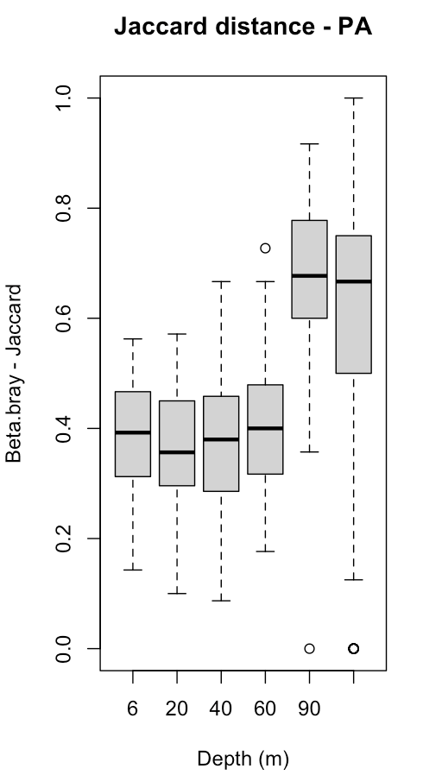
PA (0,1)
Visualization: the mean of beta.jac diversity increases with increasing depth. Boxplots represent the entire beta diversity distance object generated with beta.pair
Statistical tests:
What? If beta diversity increases with depth
Why? Because this is what we want to test according to visual interpretation
How? Doing a linear model regression
Interpretation: the linear model shows that beta.diversity is significantly increasing with increasing depth. Our model explains 70% of the data Our model allows us to predict this increase of beta.diversity with depth with the formula:
beta.div = 0.0025(Depth) + 0.323
Opinion: However, I am not sure how redundant this is with betadisper where we already show the variance according to the depth. I wanted to do a proper test with depth.
(2) Beta-diversity with depth
The mean of beta.pair “Beta.jac” per separate depths increases with increasing depth following this equation
beta.div = 0.0025(Depth) + 0.323
It is signifcant p-value <0.05
R2 = 0.70
Boxplot of beta.pair distance matrix per separate depths
Notes:
Call:
lm(formula = beta_jac ~ Depth, data = beta_div_depth)
Residuals:
1 2 3 4 5 6
0.049542 -0.009062 -0.048332 -0.075332 0.121496 -0.038312
Coefficients:
Estimate Std. Error t value Pr(>|t|)
(Intercept) 0.3239096 0.0580357 5.581 0.00505 **
Depth 0.0025945 0.0008475 3.061 0.03761 *
---
Signif. codes: 0 ‘***’ 0.001 ‘**’ 0.01 ‘*’ 0.05 ‘.’ 0.1 ‘ ’ 1
Residual standard error: 0.08182 on 4 degrees of freedom
Multiple R-squared: 0.7009, Adjusted R-squared: 0.6261
F-statistic: 9.372 on 1 and 4 DF, p-value: 0.03761

Slide 18
Occupancy (Frequency)
Visualization: The occupancy of coral diversity is well clustered with depth. Beta-diversity (size of polygon) increases even more with depth. While shallow coral diversity is very homogeneous, deep corals more diverse. Each site looks unique.
Statistical tests:
What? (1) Is variance and homocedasticity really bigger with depth ? (2) Is beta-diversity really higher in depth ? (3) is beta-diversity correlated with distance at different depths?
Why? Because understanding beta-diversity patterns with depth has important implications in conservation

Slide 19
Occupancy (Frequency)
How? (1) From Frequency matrix, using the beta-diver from “beta.bray” and doing “betadisper” will allow me to see the variance with distance to median per depth. “Anova” of betadisper, check if really depth is significantly contributing to increase variance, and permutest pair-wise comparisons between depths. (Check comments for output)
(2) using “beta.pair” at each different depth with “bray” family I can see beta-diversity and its components “beta.pair(Depth_X_Beta, index.family = "bray")”
(3) using “mantel” correlation of beta-bray pair-wise distance of separate depths with geographical distance
Interpretation: (1) distance to median increase with increasing depth (2) Beta-diversity increases clearly with depth. I made an extra figure to see the regression between beta.div and increasing depth (next slide) (3) There are not correlations nor patterns of beta-diversity with geographical distance
Opinion: As mentioned before, I left the two components (turn and nes) in blank.
(1) Distance to median from betadisper
(2) Beta-diversity with depth
(3) Mantel-tests of beta-bray with geographical distance
Depth | Beta-bray | Turn | Nest | Mantel Stat. | Signif.
6m | 0.2892 | X | X | 0.2859 | 0.063
20m | 0.3269 |  |  | -0.0891 | 0.53
40m | 0.4554 |  |  | 0.2603 | 0.04
60m | 0.4399 |  |  | 0.6106 | 0.005
90m | 0.5418 |  |  | 0.4054 | 0.038
120m | 0.6869 |  |  | 0.1075 | 0.215
Notes:
(1)
> mod_Depth <- betadisper (Beta_Depth,groups)
> mod_Depth
Homogeneity of multivariate dispersions
Call: betadisper(d = Beta_Depth, group = groups)
No. of Positive Eigenvalues: 46
No. of Negative Eigenvalues: 48
Average distance to median:
120M 20M 40M 60M 6M 90M
0.4484 0.2243 0.3139 0.2988 0.1973 0.3682
Eigenvalues for PCoA axes:
(Showing 8 of 94 eigenvalues)
PCoA1 PCoA2 PCoA3 PCoA4 PCoA5 PCoA6 PCoA7 PCoA8
10.3503 3.8844 1.8291 1.1541 0.9625 0.8460 0.8331 0.7019
> anova(mod_Depth)
Analysis of Variance Table
Response: Distances
Df Sum Sq Mean Sq F value Pr(>F)
Groups 5 0.66344 0.132688 12.319 4.369e-09 ***
Residuals 89 0.95862 0.010771
---
Signif. codes: 0 ‘***’ 0.001 ‘**’ 0.01 ‘*’ 0.05 ‘.’ 0.1 ‘ ’ 1
> # Permutation test for F
> permutest(mod_Depth, pairwise = TRUE, permutations = 99)
Permutation test for homogeneity of multivariate dispersions
Permutation: free
Number of permutations: 99
Response: Distances
Df Sum Sq Mean Sq F N.Perm Pr(>F)
Groups 5 0.66344 0.132688 12.319 99 0.01 **
Residuals 89 0.95862 0.010771
---
Signif. codes: 0 ‘***’ 0.001 ‘**’ 0.01 ‘*’ 0.05 ‘.’ 0.1 ‘ ’ 1
Pairwise comparisons:
(Observed p-value below diagonal, permuted p-value above diagonal)
120M 20M 40M 60M 6M 90M
120M 1.0000e-02 1.0000e-02 1.0000e-02 1.0000e-02 0.12
20M 4.9842e-07 1.0000e-02 4.0000e-02 1.6000e-01 0.01
40M 1.4382e-03 4.1189e-04 7.6000e-01 1.0000e-02 0.19
60M 1.5721e-03 1.6867e-02 6.4992e-01 1.0000e-02 0.18
6M 1.1270e-07 1.6338e-01 3.7132e-05 2.4265e-03 0.01
90M 1.3494e-01 1.4882e-03 2.2532e-01 1.5627e-01 3.1772e-04
> TukeyHSD(mod_Depth)
Tukey multiple comparisons of means
95% family-wise confidence level
Fit: aov(formula = distances ~ group, data = df)
$group
diff lwr upr p adj
20M-120M -0.22407564 -0.33271954 -0.115431748 0.0000006
40M-120M -0.13442625 -0.24307014 -0.025782355 0.0066442
60M-120M -0.14957551 -0.25821940 -0.040931612 0.0017091
6M-120M -0.25106612 -0.35971002 -0.142422229 0.0000000
90M-120M -0.08021731 -0.18886121 0.028426584 0.2715053
40M-20M 0.08964939 -0.01722782 0.196526602 0.1528626
60M-20M 0.07450014 -0.03237707 0.181377345 0.3337544
6M-20M -0.02699048 -0.13386769 0.079886728 0.9769481
90M-20M 0.14385833 0.03698112 0.250735541 0.0023277
60M-40M -0.01514926 -0.12202647 0.091727952 0.9984145
6M-40M -0.11663987 -0.22351708 -0.009762665 0.0241257
90M-40M 0.05420894 -0.05266827 0.161086148 0.6794363
6M-60M -0.10149062 -0.20836783 0.005386592 0.0726500
90M-60M 0.06935820 -0.03751901 0.176235405 0.4149241
90M-6M 0.17084881 0.06397160 0.277726022 0.0001595

Slide 20
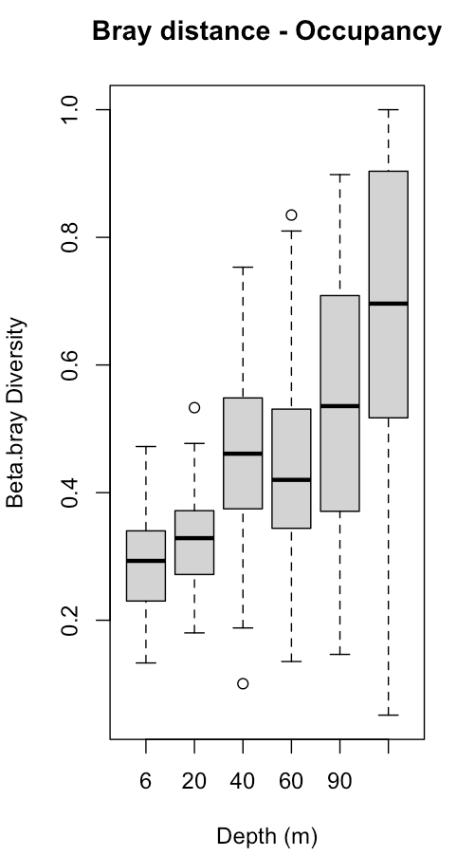
Occupancy (Frequency)
Visualization: the mean of beta.bray diversity increases with increasing depth very clear. Boxplots represent the entire beta diversity distance object generated with beta.pair
Statistical tests:
What? If beta diversity increases with depth
Why? Because this is what we want to test according to visual interpretation
How? Doing a linear model regression
Interpretation: the linear model shows that beta.diversity is significantly increasing with increasing depth. Our model explains 95% of the data Our model allows us to predict this increase of beta.diversity with depth with the formula:
beta.div =0.0032(Depth) +0.272
Opinion: However, I am not sure how redundant this is with betadisper where we already show the variance according to the depth. I wanted to do a proper test with depth.
(2) Beta-diversity with depth
The mean of beta.pair “Beta.bray” per separate depths increases with increasing depth following this equation
beta.div =0.0032(Depth) +0.272
It is signifcant p-value <0.005
R2 = 0.95
Boxplot of beta.pair distance matrix per separate depths
Notes:
Call:
lm(formula = beta_bray ~ Depth, data = beta_div_depth)
Residuals:
1 2 3 4 5 6
-0.003162 -0.011533 0.051313 -0.029888 -0.026599 0.019869
Coefficients:
Estimate Std. Error t value Pr(>|t|)
(Intercept) 0.2726726 0.0244990 11.130 0.000371 ***
Depth 0.0032862 0.0003578 9.186 0.000780 ***
---
Signif. codes: 0 ‘***’ 0.001 ‘**’ 0.01 ‘*’ 0.05 ‘.’ 0.1 ‘ ’ 1
Residual standard error: 0.03454 on 4 degrees of freedom
Multiple R-squared: 0.9547, Adjusted R-squared: 0.9434
F-statistic: 84.37 on 1 and 4 DF, p-value: 0.0007801

Slide 21
Abundance (Coral Cover)
Visualization: The coral cover of coral diversity is well clustered with depth. Beta-diversity (size of polygon) increases with depth. Even more than with PA or Frequency. While shallow coral diversity is very homogeneous, deep corals more diverse. Each site looks unique.
Statistical tests:
What? (1) Is variance and homocedasticity really bigger with depth ? (2) Is beta-diversity really higher in depth ? (3) is beta-diversity correlated with distance at different depths?
Why? Because understanding beta-diversity patterns with depth has important implications in conservation
Check next slide

Slide 22
Abundance (Coral Cover)
How? (1) From Coral cover matrix, using the beta-diver from “beta.bray” and doing “betadisper” will allow me to see the variance with distance to median per depth. “Anova” of betadisper, check if really depth is significantly contributing to increase variance, and permutest pair-wise comparisons between depths. (Check comments for output)
(2) using “beta.pair” at each different depth with “bray” family I can see beta-diversity and its components “beta.pair(Depth_X_Beta, index.family = "bray")” (3) using “mantel” correlation of beta-bray pair-wise distance of separate depths with geographical distance
Interpretation: (1) distance to median increases with increasing depth (2) Beta-diversity increases with depth and is higher than for the other databases. (3) There are strong correlations of beta-diversity with geographical distance in the surface, and weak correlations in the zone of 60-90m
Opinion: To avoid tables, I made an extra figure to see the regresion between beta.div and increasing depth
(1) Distance to median from betadisper
(2) Beta-diversity with depth
(3) Mantel-tests of beta-jac with geographical distance
Depth | Beta-bray | Turn | Nest | Mantel Stat. | Signif.
6m | 0.4485 |  |  | 0.6224 | 9.9e-05
20m | 0.5844 |  |  | 0.078 | 0.198
40m | 0.7091 |  |  | 0.1447 | 0.124
60m | 0.7276 |  |  | 0.3343 | 0.006
90m | 0.7732 |  |  | 0.3903 | 0.0085
120m | 0.8037 |  |  | 0.359 | 0.025
Notes:
(1)
> mod_Depth <- betadisper (Beta_Depth,groups, type = "median", bias.adjust=TRUE)
> mod_Depth
Homogeneity of multivariate dispersions
Call: betadisper(d = Beta_Depth, group = groups, type = "median", bias.adjust = TRUE)
No. of Positive Eigenvalues: 51
No. of Negative Eigenvalues: 42
Average distance to median:
120M 20M 40M 60M 6M 90M
0.5755 0.4232 0.5143 0.5257 0.3149 0.5516
Eigenvalues for PCoA axes:
(Showing 8 of 93 eigenvalues)
PCoA1 PCoA2 PCoA3 PCoA4 PCoA5 PCoA6 PCoA7 PCoA8
8.463 4.384 3.181 2.746 2.296 1.914 1.760 1.245
> anova(mod_Depth)
Analysis of Variance Table
Response: Distances
Df Sum Sq Mean Sq F value Pr(>F)
Groups 5 0.74908 0.149817 10.435 6.981e-08 ***
Residuals 88 1.26344 0.014357
---
Signif. codes: 0 ‘***’ 0.001 ‘**’ 0.01 ‘*’ 0.05 ‘.’ 0.1 ‘ ’ 1
> permutest(mod_Depth, pairwise = TRUE, permutations = 999)
Permutation test for homogeneity of multivariate dispersions
Permutation: free
Number of permutations: 999
Response: Distances
Df Sum Sq Mean Sq F N.Perm Pr(>F)
Groups 5 0.74908 0.149817 10.435 999 0.001 ***
Residuals 88 1.26344 0.014357
---
Signif. codes: 0 ‘***’ 0.001 ‘**’ 0.01 ‘*’ 0.05 ‘.’ 0.1 ‘ ’ 1
Pairwise comparisons:
(Observed p-value below diagonal, permuted p-value above diagonal)
120M 20M 40M 60M 6M 90M
120M 2.0000e-03 1.5900e-01 2.4100e-01 1.0000e-03 0.619
20M 8.9939e-04 6.0000e-03 5.0000e-03 2.4000e-02 0.003
40M 1.5904e-01 6.6414e-03 7.1100e-01 1.0000e-03 0.385
60M 2.4976e-01 2.7110e-03 7.3128e-01 1.0000e-03 0.553
6M 3.1879e-05 1.6909e-02 8.4319e-05 4.1716e-05 0.001
90M 6.4987e-01 4.7827e-03 3.9499e-01 5.5376e-01 8.6600e-05
> TukeyHSD(mod_Depth)
Tukey multiple comparisons of means
95% family-wise confidence level
Fit: aov(formula = distances ~ group, data = df)
$group
diff lwr upr p adj
20M-120M -0.15223719 -0.279993525 -0.02448086 0.0101160
40M-120M -0.06115129 -0.188907616 0.06660505 0.7301760
60M-120M -0.04978652 -0.177542847 0.07796981 0.8652770
6M-120M -0.26056805 -0.388324385 -0.13281172 0.0000008
90M-120M -0.02386048 -0.151616807 0.10389585 0.9941326
40M-20M 0.09108591 -0.032338432 0.21451025 0.2718683
60M-20M 0.10245068 -0.020973663 0.22587502 0.1612480
6M-20M -0.10833086 -0.231755202 0.01509348 0.1191705
90M-20M 0.12837672 0.004952376 0.25180106 0.0365998
60M-40M 0.01136477 -0.112059572 0.13478911 0.9998055
6M-40M -0.19941677 -0.322841110 -0.07599243 0.0001326
90M-40M 0.03729081 -0.086133533 0.16071515 0.9502840
6M-60M -0.21078154 -0.334205879 -0.08735720 0.0000462
90M-60M 0.02592604 -0.097498302 0.14935038 0.9899025
90M-6M 0.23670758 0.113283237 0.36013192 0.0000037

Slide 23
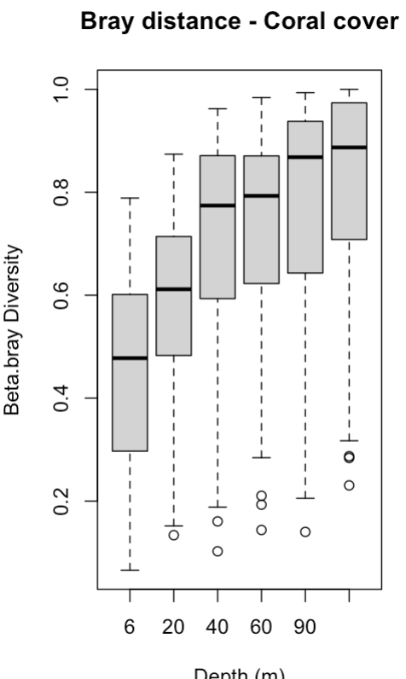
Abundance (Coral Cover)
Visualization: the mean of beta.bray diversity increases with increasing depth. Boxplots represent the entire beta diversity distance object generated with beta.pair
Statistical tests:
What? If beta diversity increases with depth
Why? Because this is what we want to test according to visual interpretation
How? Doing a linear model regression
Interpretation: the linear model shows that beta.diversity is significantly increasing with increasing depth. Our model explains 79% of the data Our model allows us to predict this increase of beta.diversity with depth with the formula:
beta.div = 0.0027(Depth) +0.5192
Opinion: However, I am not sure how redundant this is with betadisper where we already show the variance according to the depth. I wanted to do a proper test with depth.
(2) Beta-diversity with depth
The mean of beta.pair “Beta.bray” per separate depths increases with increasing depth following this equation
beta.div = 0.0027(Depth) +0.5192
It is signifcant p-value <0.05
R2 = 0.79
Boxplot of beta.pair distance matrix per separate depths
Notes:
Call:
lm(formula = beta_bray ~ Depth, data = beta_div_depth)
Residuals:
1 2 3 4 5 6
-0.087342 0.009731 0.079016 0.042096 0.004559 -0.048061
Coefficients:
Estimate Std. Error t value Pr(>|t|)
(Intercept) 0.5192404 0.0476750 10.891 0.000403 ***
Depth 0.0027716 0.0006962 3.981 0.016387 *
---
Signif. codes: 0 ‘***’ 0.001 ‘**’ 0.01 ‘*’ 0.05 ‘.’ 0.1 ‘ ’ 1
Residual standard error: 0.06721 on 4 degrees of freedom
Multiple R-squared: 0.7985, Adjusted R-squared: 0.7481
F-statistic: 15.85 on 1 and 4 DF, p-value: 0.01639

Slide 24
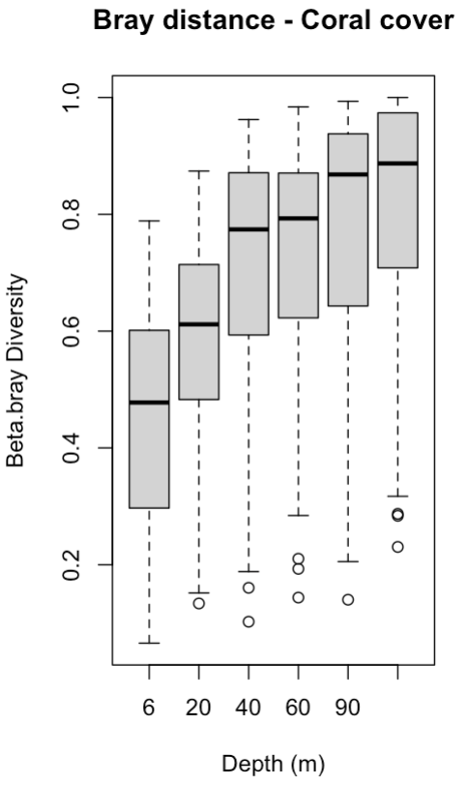
Personally, I think this is figure 3. Regressions between beta.diversity and increasing depth
Lm (beta_jac ~ Depth)
beta.div = 0.0025* x (Depth) + 0.323**
Multiple R-squared: 0.7009, Adjusted R-squared: 0.6261
F-statistic: 9.372 on 1 and 4 DF
p-value: 0.03761
Lm (beta_bray~ Depth)
beta.div = 0.00328*** x (Depth) + 0.2726***
Multiple R-squared: 0.9547, Adjusted R-squared: 0.9434
F-statistic: 84.37 on 1 and 4 DF
p-value: 0.0007801
Lm (beta_bray ~ Depth)
beta.div = 0.0027* x (Depth) +0.5192***
Multiple R-squared: 0.7985, Adjusted R-squared: 0.7481
F-statistic: 15.85 on 1 and 4 DF
p-value: 0.01639
Notes:
Otherwise, omit Fig 2 (below) which is distance to median and combine NMDS with this figure 3.

Slide 25
Discussion
Coral cover decreases with light! Generic Richness and mid-domain effect
Unexpected results of higher (beta) diversity at MCEs - novelty. Results consistent with the three databases. Predicting beta-diversity patterns in depth. Bibliography comparison.
Hypothesis of why we believe is like this. Although higher diversity should be in shallow waters, in shallow waters competition is high and dominated by particular corals. In depth competition smaller then more diversity. Was is not like this, and now exposed to global changes only some are surviving while in depth they are all present?
Conservation perspective (shallow reefs homogeneous), (MCE diverse and unique)
SLOSS debate protection to preserve diversity
Protect diversity at local scale vs regional scale (almost impossible)
Perspectives. First people studying this beta.diversity patterns at MCEs. Same in other places ? Perspective improve study looking at species level. Really necessary to keep researching on MCEs as diversity seems to be unique.

Slide 26
Supplementary data
Correlations between species and genus level with other available databases.
Stack area plot of generic composition to show this are so diverse
Maybe some of the boxplots of betadisper if we drop them ?

Slide 27
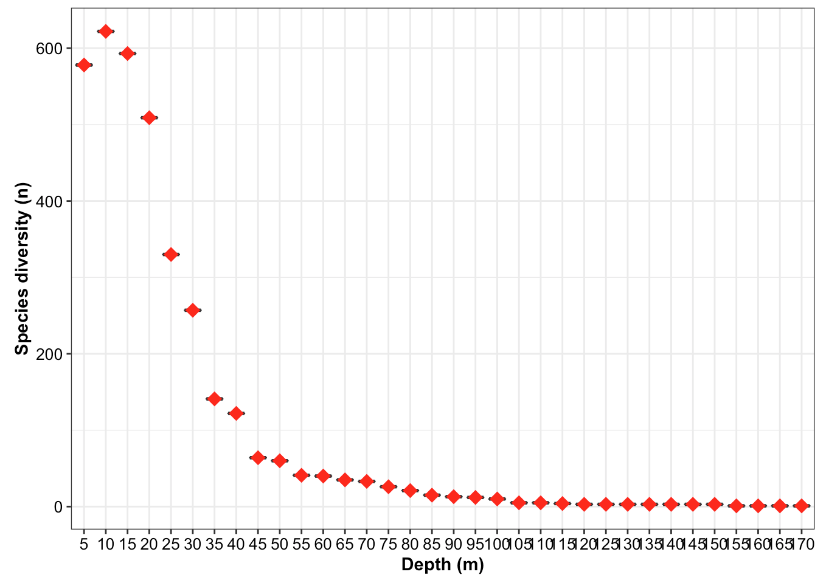
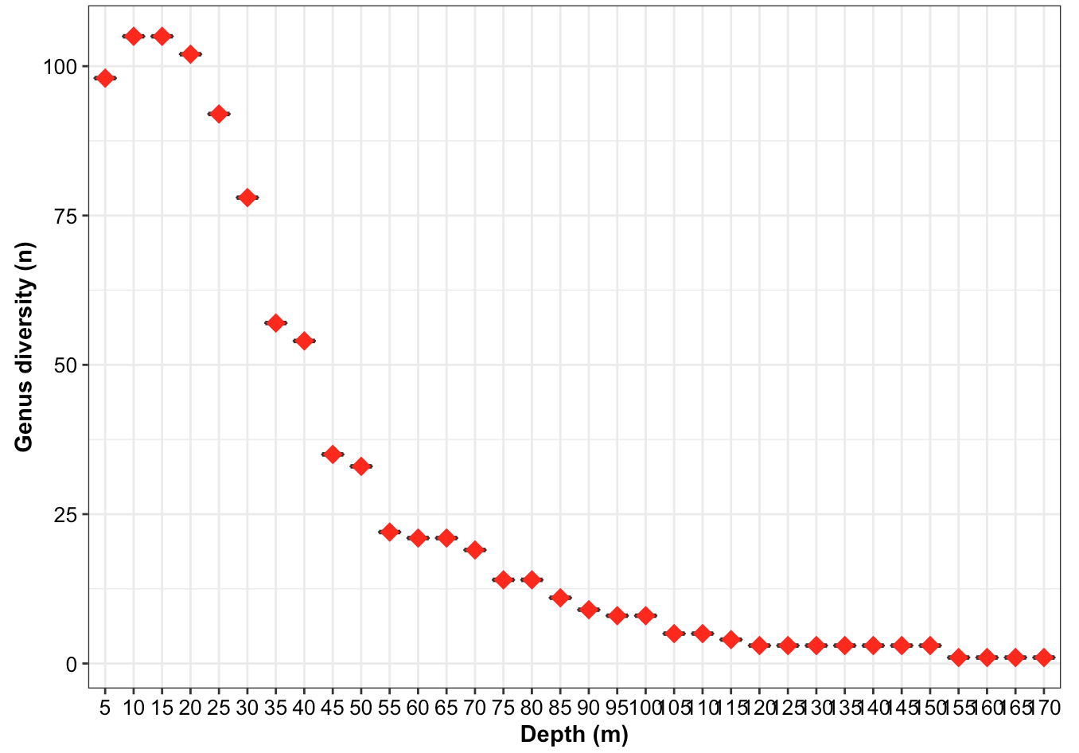
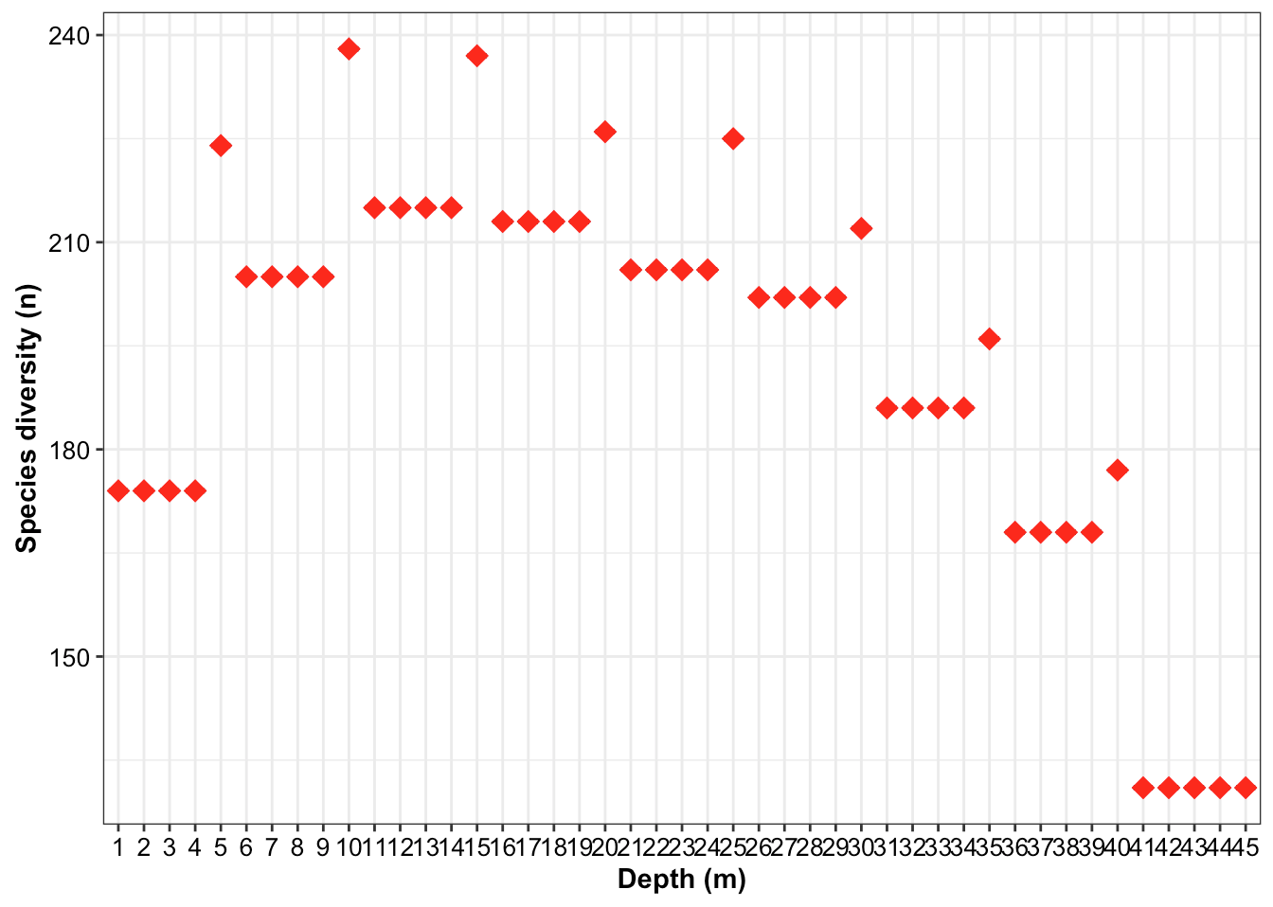
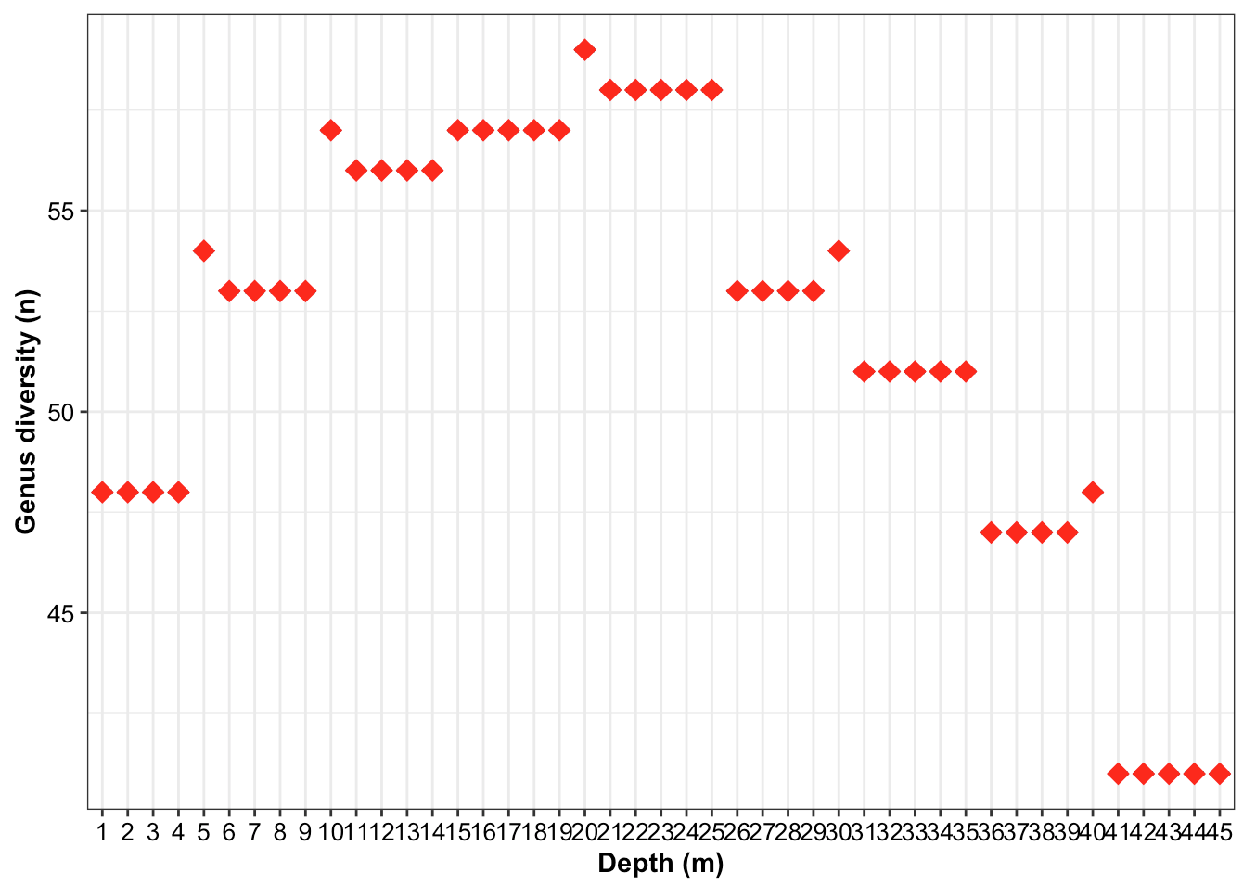
Results Counterbalancing generic level vs. species level
Generic richness vs Specific richness are highly correlated for available open databases
Rocha 2018 database
Roberts 2019 database
Unpublished database Madagascar from Michel Pichon
Pearson's t = 17.614, df = 32, p-value < 2.2e-16 ## 95 percent confidence interval: 0.9054739 & 0.9760216 ## sample estimates cor : 0.9521049
Spearman #rho = 0.9993824 / Kendall #tau = 0.9924741
Pearson's t = 21.243, df = 43, p-value < 2.2e-16 ## 95 percent confidence interval: 0.9200211 & 0.9754550 ## sample estimates cor : 0.9555119
Spearman #rho = 0.921 / Kendall #tau = 0.8128814
Pearson's t = 36.605, df = 58, p-value < 2.2e-16 ## 95 percent confidence interval: 0.9650134 0.9874726 ## sample estimates cor : 0.9790347
Spearman #rho = 0.999071/ Kendall #tau = 0.991986

Slide 28
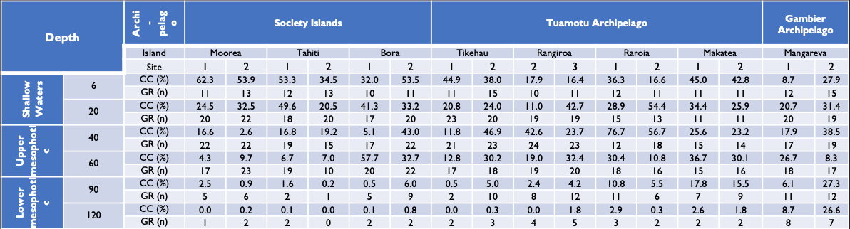
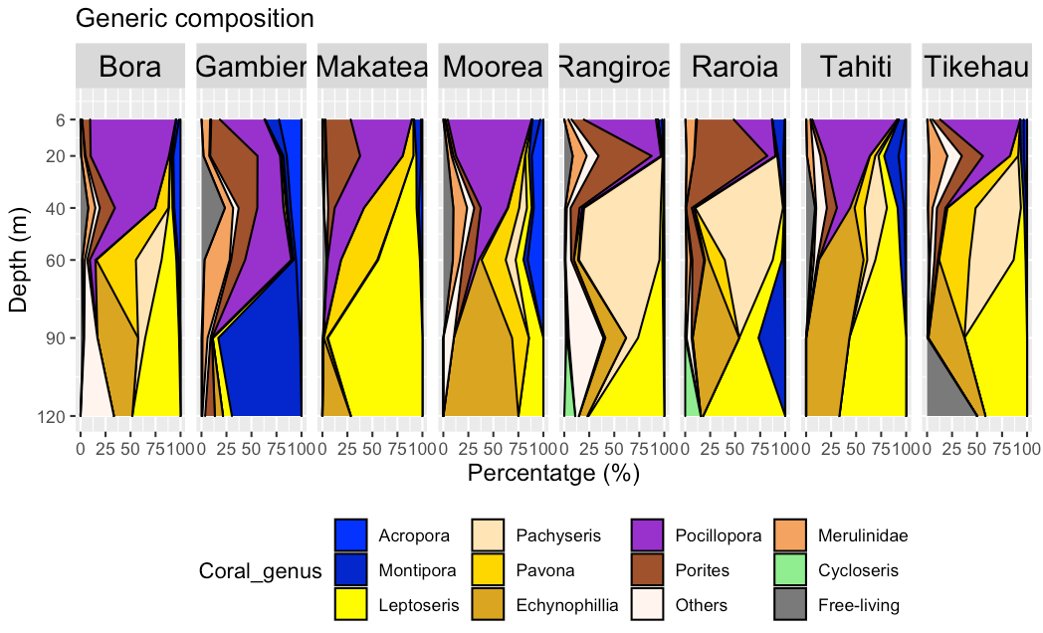
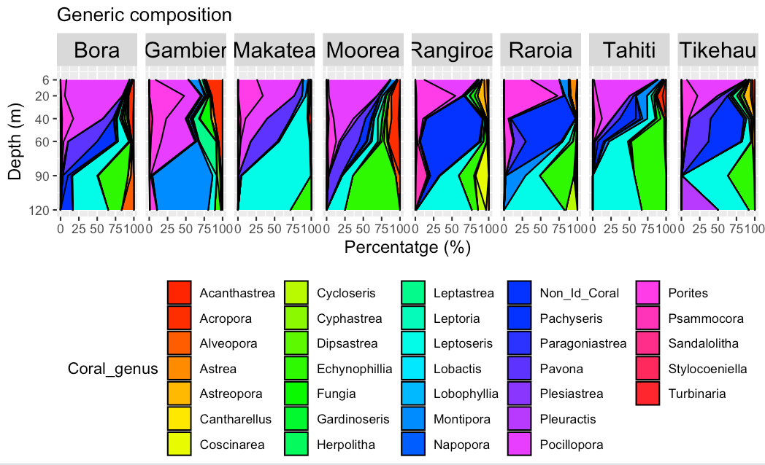
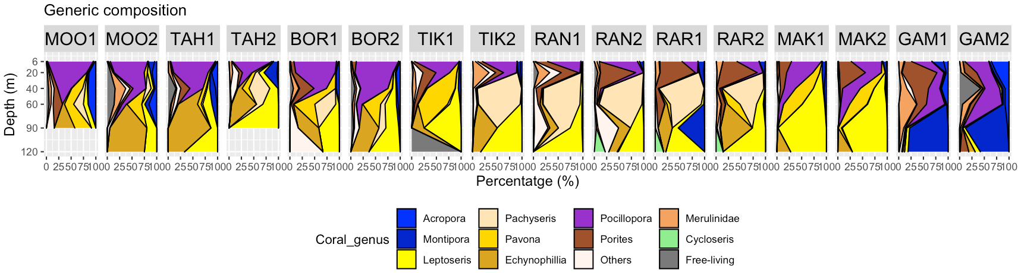
Supplementary data
Notes:
To show the differences of coral cover diversity in depth.
For me the best is the grouped ones in most common genera and families and one graph per island.

